Slide 1
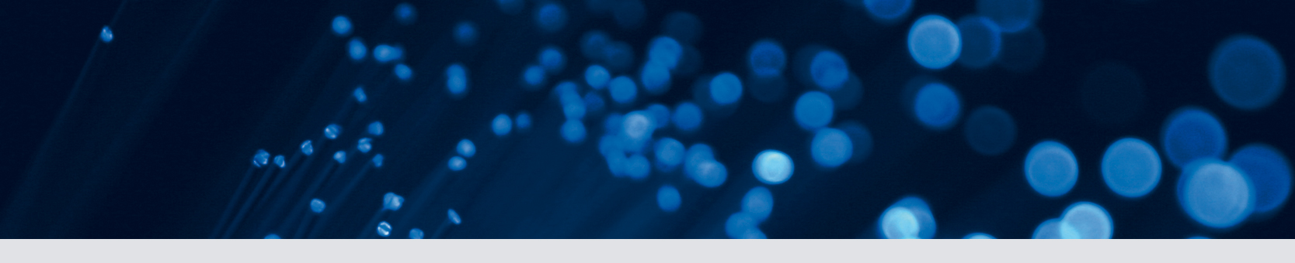


Unsupervised domain adaptation in brain lesion segmentation with adversarial networks
Konstantinos Kamnitsas, Christian Baumgartner, Christian Ledig,
Virginia Newcombe, Joanna Simpson, Andrew Kane, David Menon,
Aditya Nori, Antonio Criminisi, Daniel Rueckert, and Ben Glocker

Slide 2
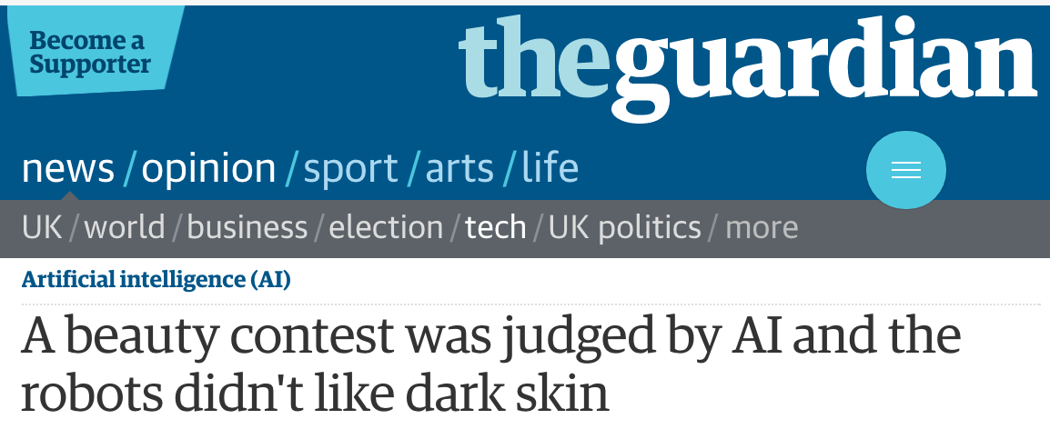
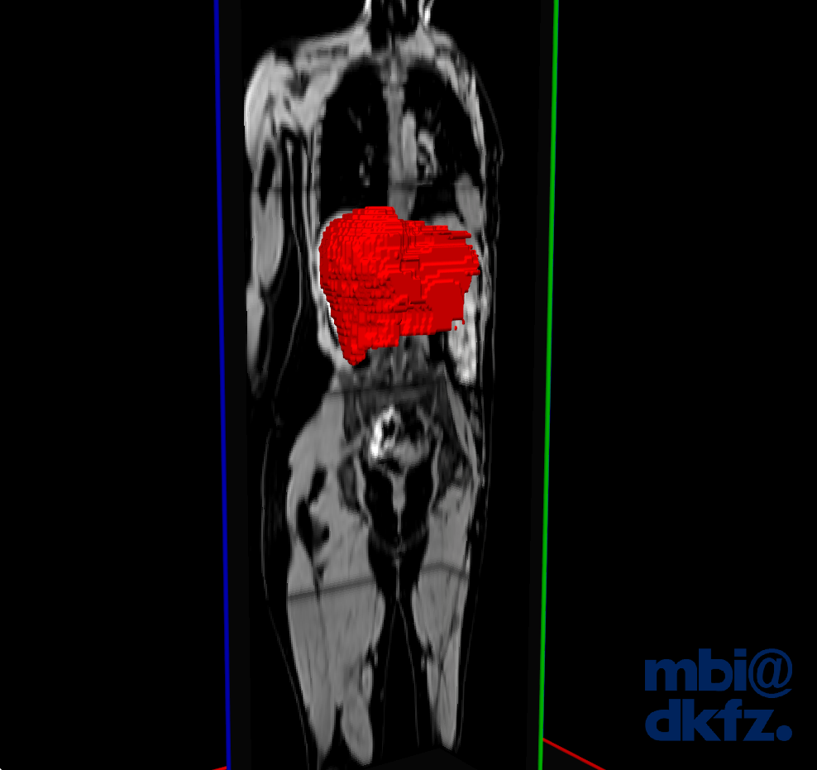
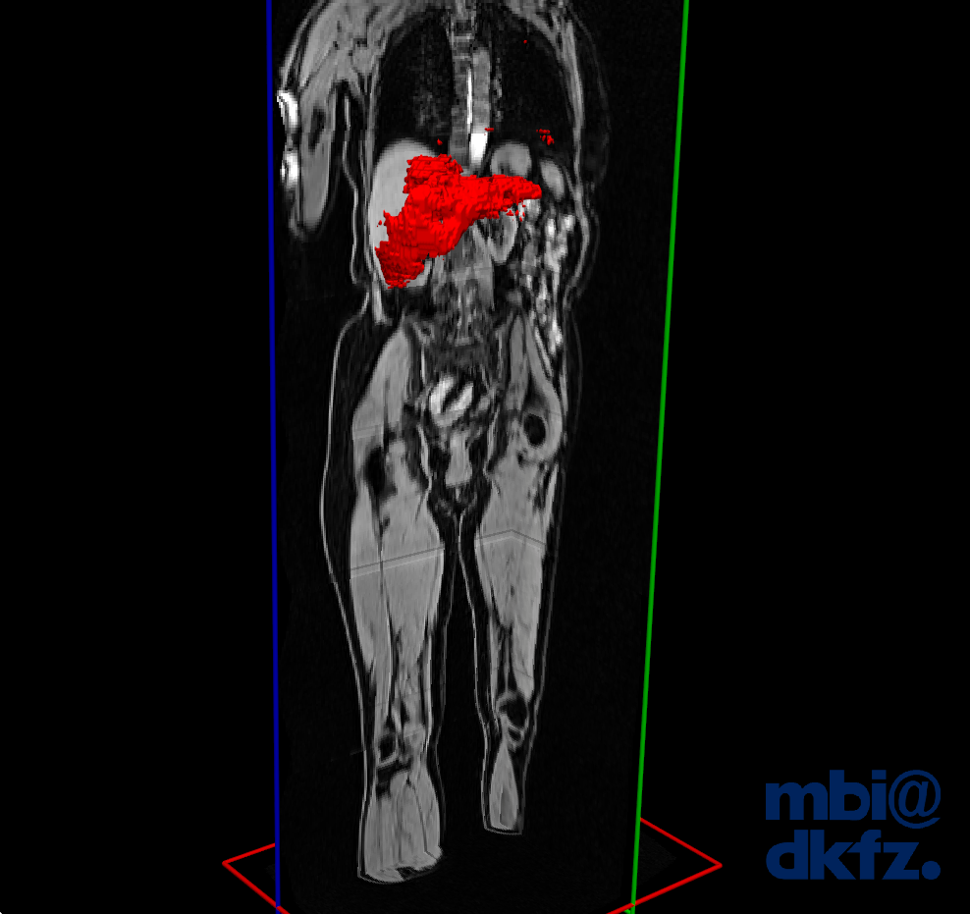
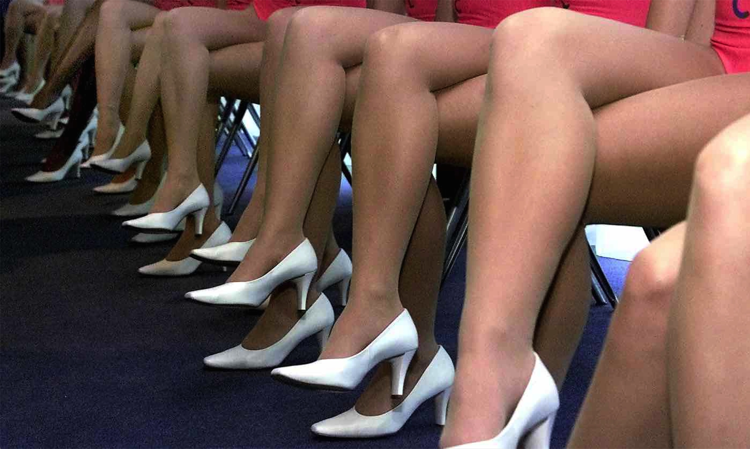

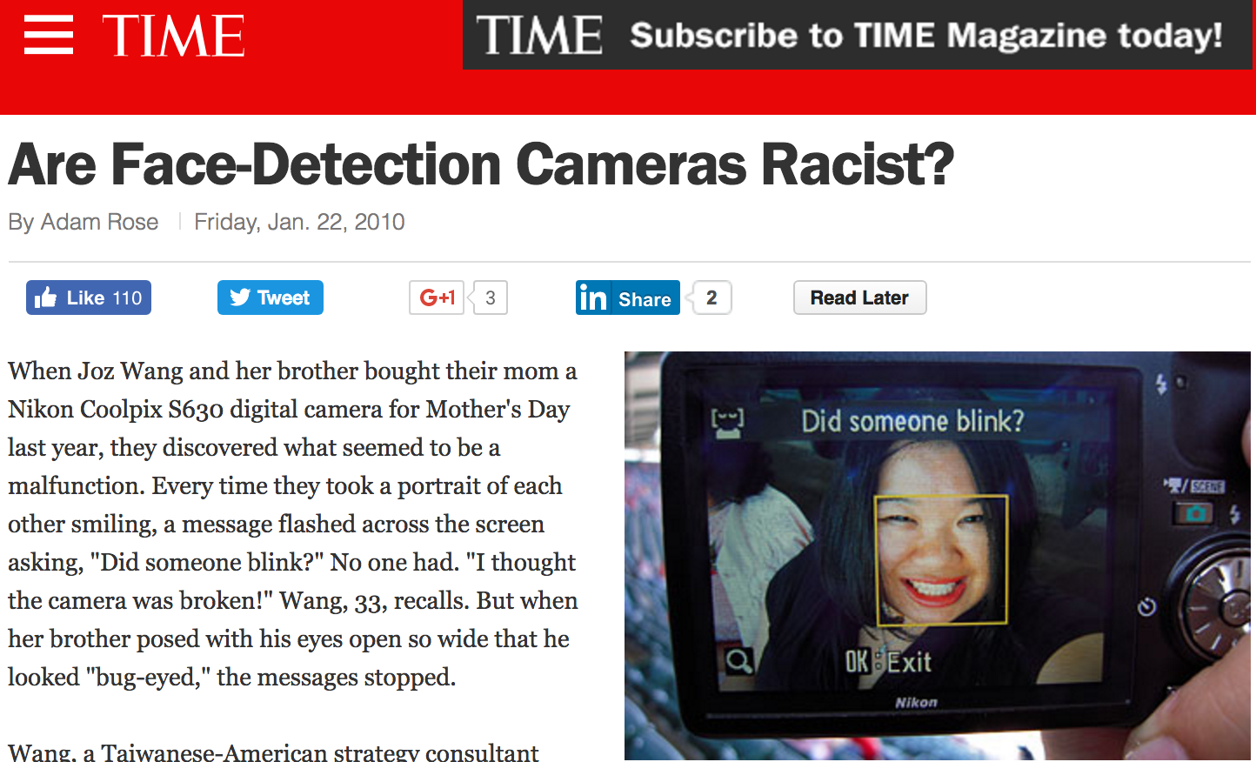
Scaling up ML adoption
(Deep?) Machine Learning performs well!
…well...
…in the lab.
x
Lab
Deployment
“…the main problem was that the data the project used to establish standard of attractiveness did not include enough minorities.”
- The Guardian (url)
“You would think that Nikon, being a Japanese company, would have designed this with Asian eyes in mind.”
- Random commenter(url)
Notes:
Fail to generalize in the wild or a deployment environment..

Slide 3
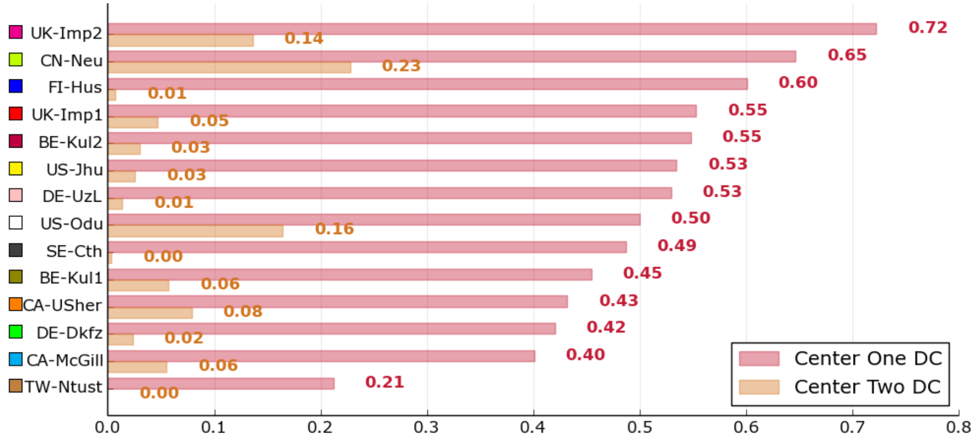
Performance degradation on biomedical benchmarks
DSC of methods on the testing data of ISLES’15. From [Maier MedIA’17]
Ischemic Stroke Lesion Segmentation (ISLES) 2015
Train data: Center One
Test data: Center One + Center Two
Performances on Center Two
Performances on Center One
Brain Tumor Segmentation 2015
Train and Test: Multiple Centers
DSC of methods in validation and testing stage of BRATS’15. Reported online.
DSC(%) on: | Whole Tumor |  |  | Core Tumor |  |  | Enhancing Tumor
 | Val. | Test | Diff. | Val. | Test | Diff. | Val. | Test | Diff.
Bakas BrainLesion’16 | 88 | 81 | -7 | 77 | 63 | -14 | 68 | 58 | -10
Peres TMI’16 | 87 | 83 | -4 | 73 | 72 | -1 | 68 | 60 | -8
Kamnitsas MedIA’17 | 90 | 84 | -6 | 75 | 65 | -10 | 73 | 62 | -11

Slide 4
Domain Shift
Source (S)
Domain:
Task:
Given:
Learn:
Target (T)
Source (S)
Target (T)
Domain:
Task:
Here:
Domain Shift:

Slide 5
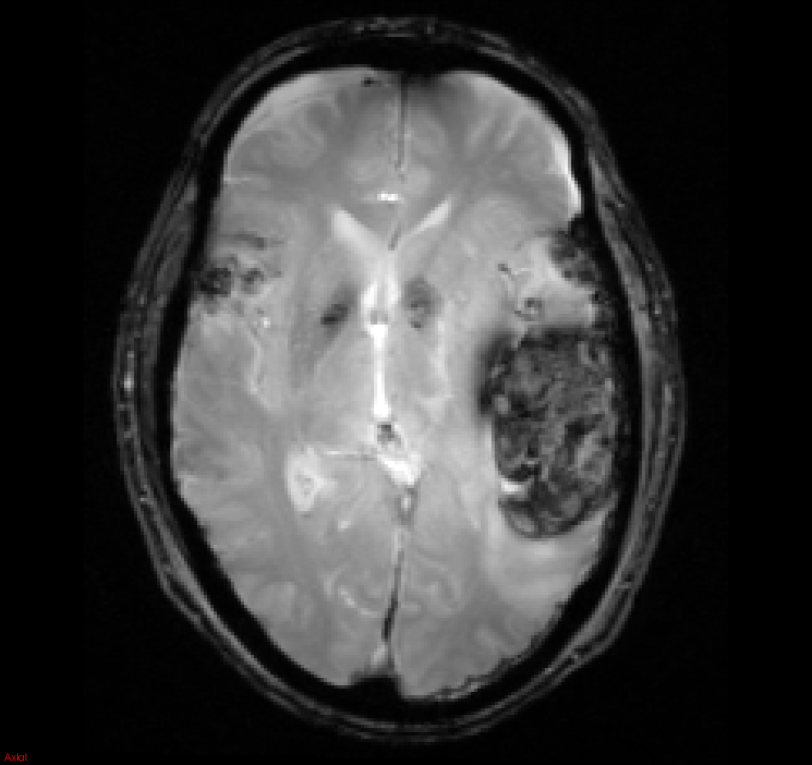
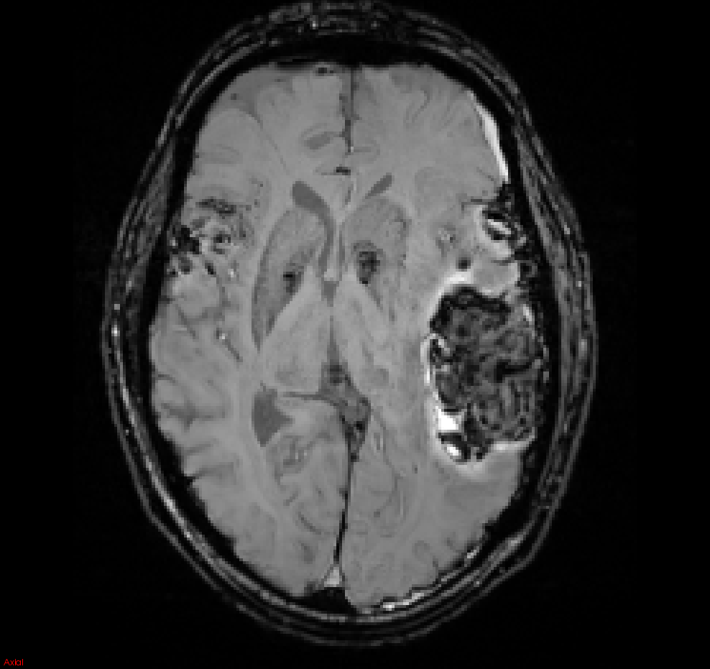
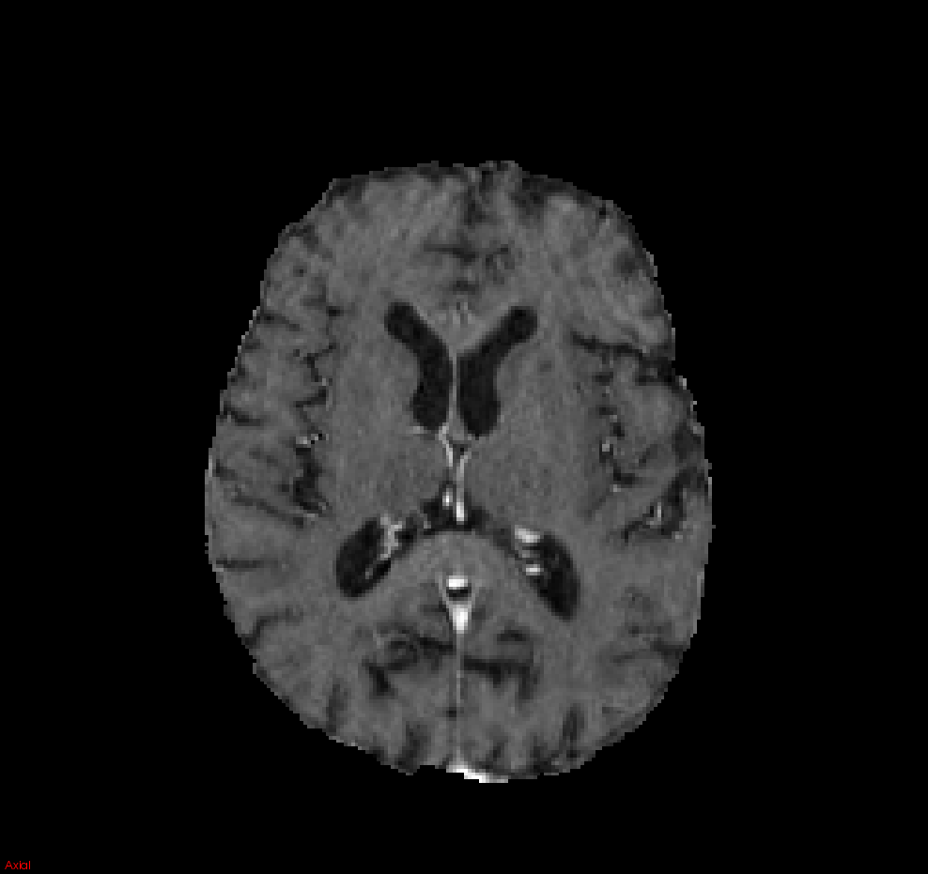
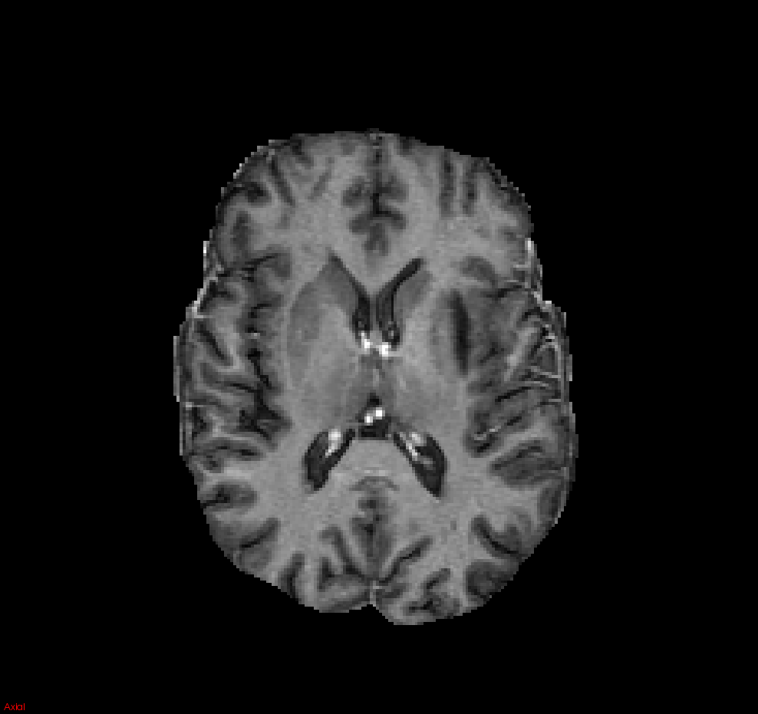
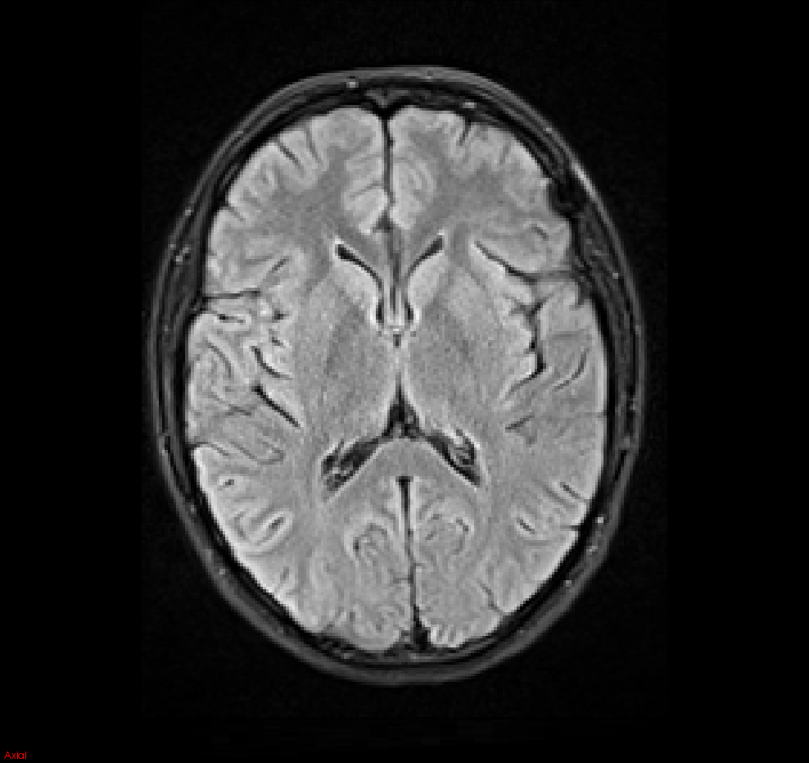
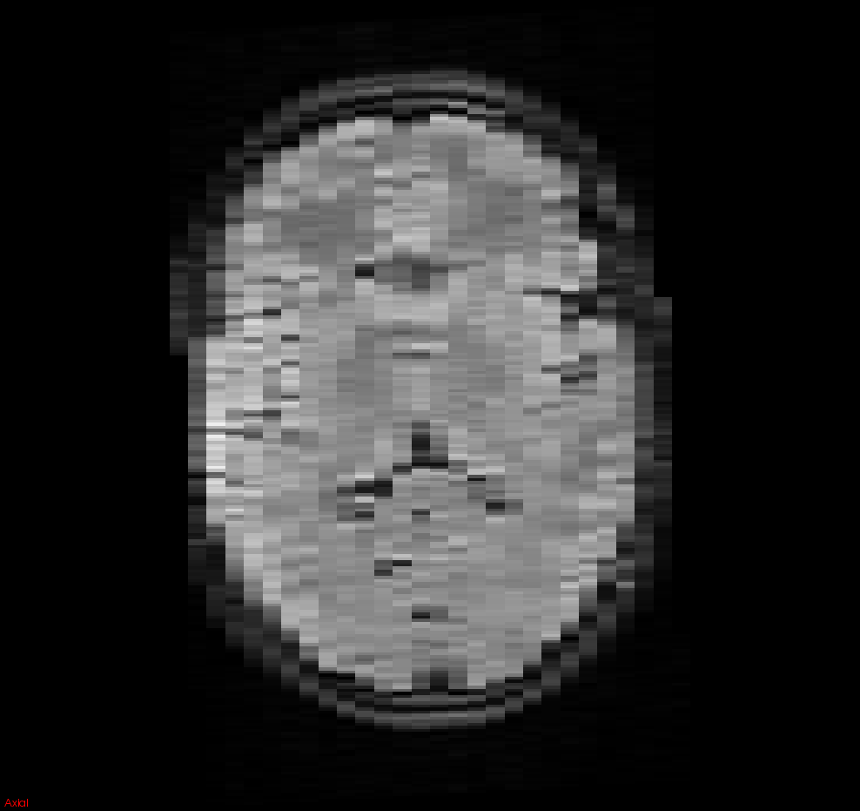
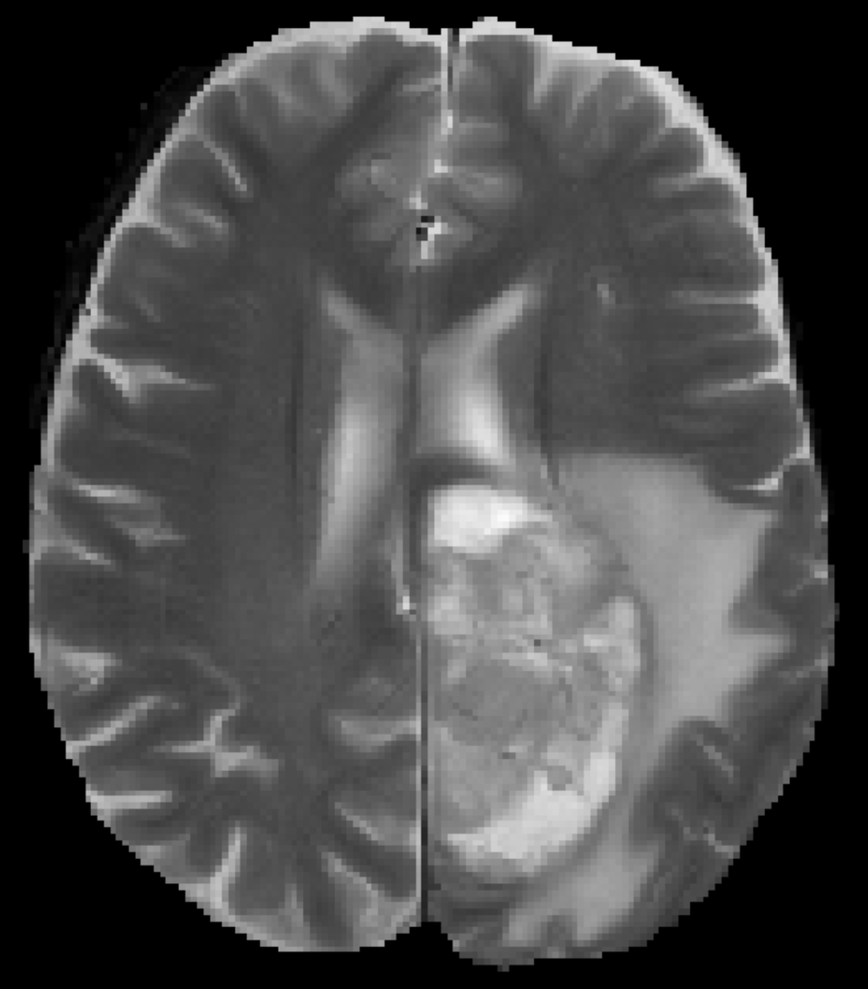
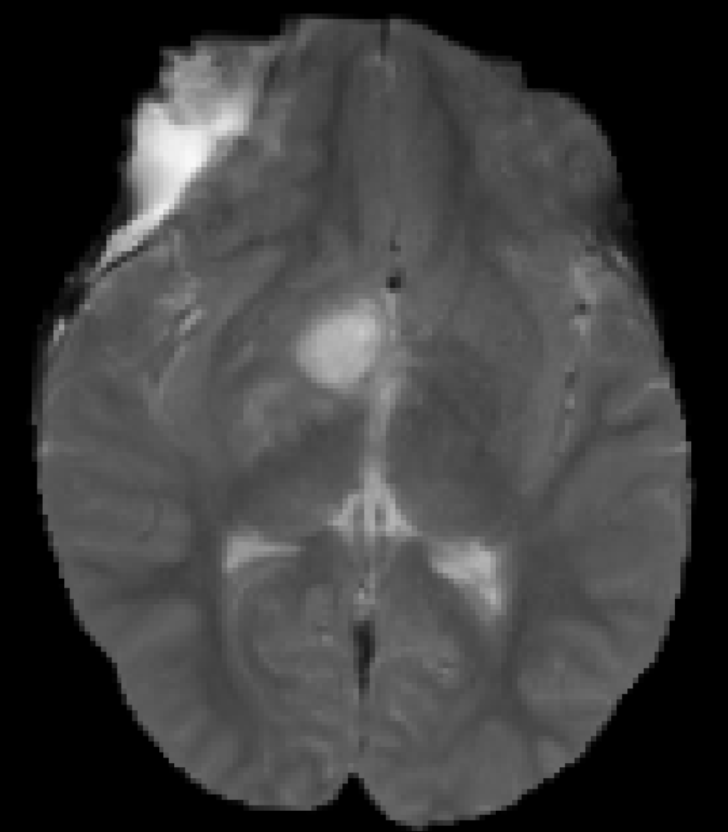
Training labels for all domains: Not a scalable solution
Multiple sources of domain variation
Protocol of acquisition:
Modalities, contrast, axis of acq., resolution…
Different Scanners:
1.5T / 3T / 5T, bias field, noise…
Biased database:
Severity of pathology, age, motion levels, artifacts
Modalities
Contrast
Large scale, multi-center studies impeded.
Release of tools “in the wild” problematic.
Technologies and specifications will change!
Acq. Axis
New scanners
Evolving protocols and clinical standards
Previous manual annotations useless.
Old trained models obsolete.
Artifacts
Notes:
Not only Neural Networks require loads of data. Even simplest models, when configured, should be done on database that represents population. In Medical, variance is big, and thus big databases required.

Slide 6
Domain Adaptation (DA)
Explores learning a predictor that performs well on both domains S and T.
Assumptions:
Such an exists [Ben-David ML’10].
Labeled data in S (with same label spaces ).
Availability of unlabeled data in T.
Little or no labels in T.
Unsupervised DA – No labels in T
The real deal!
Supervised DA – Little labels in T :
[van Oprbroek TMI’15] Adaptive SVMs.
[Becker TMI’15] Adapt trees via boosting.
[Conjeti MedIA’16] Adapt tree’s splits.

Slide 7
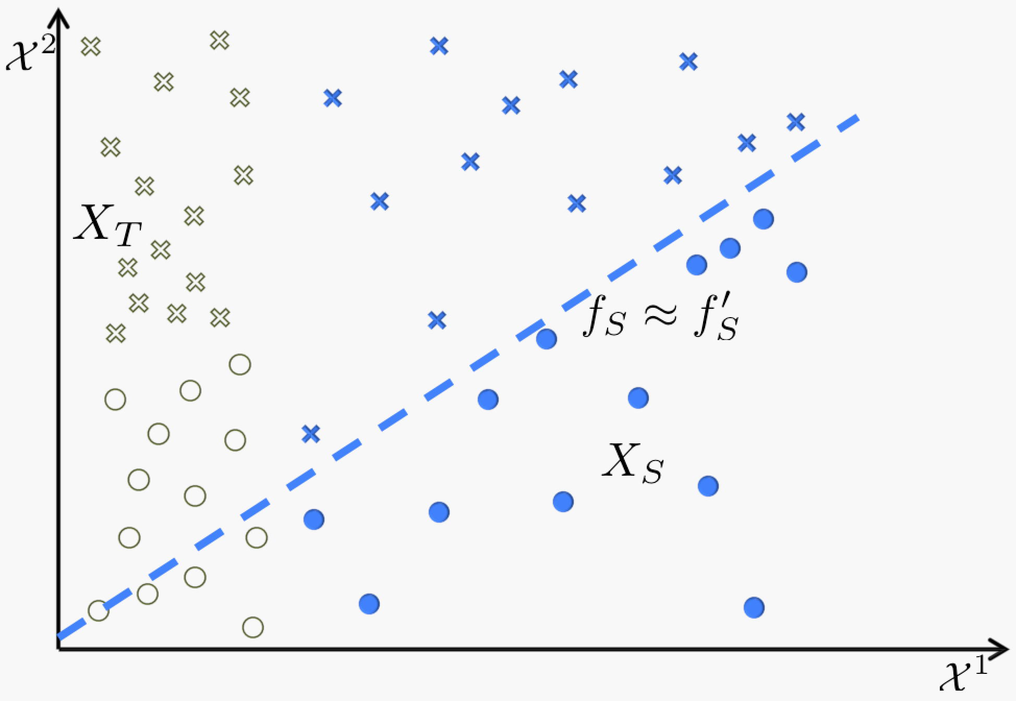
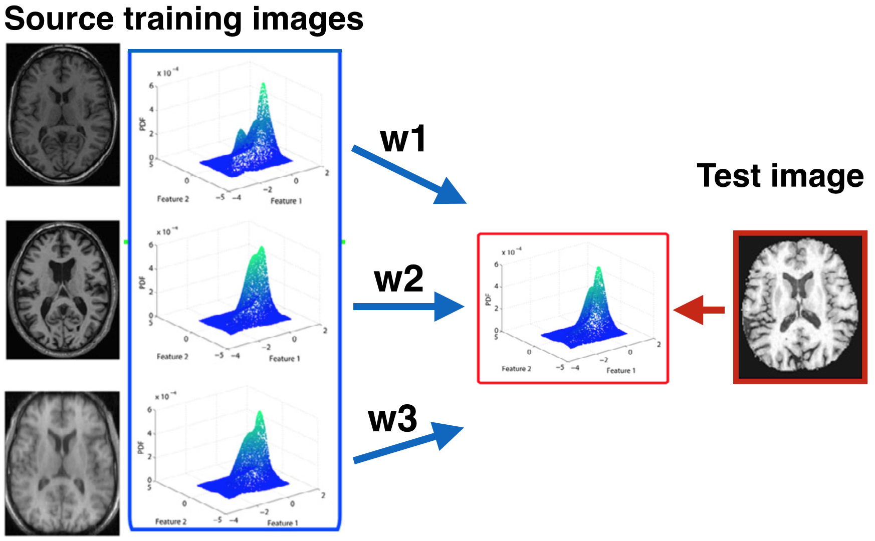
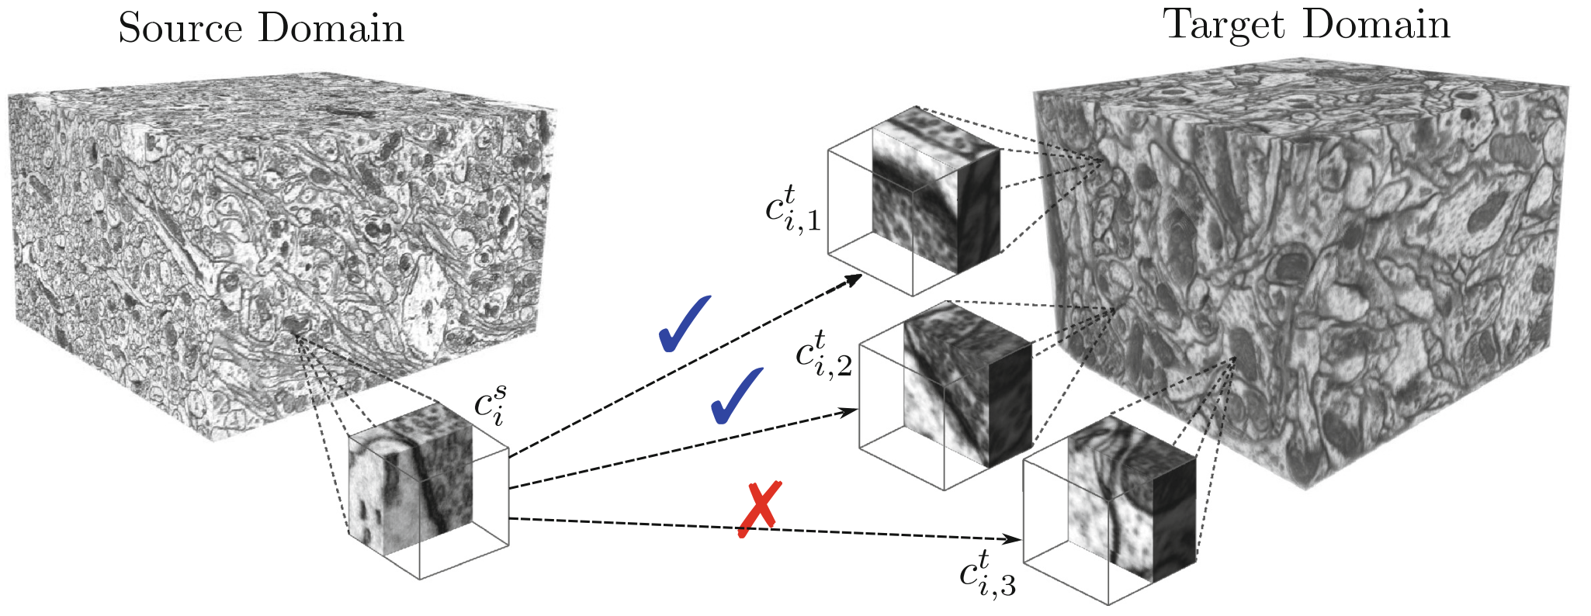
Unsupervised Domain Adaptation (UDA)
The truly scalable solution.
Needs only unlabeled data from domain T.
Challenging: No knowledge of .
Previous approaches:
[van Opbroek MedIA’15]: Weight each S training image to recreate PDF of T image.
- Process & training repeated for every test image. - Training images must cover range of domains/PDFs.
[Chacon MICCAI’16]: Find visual correspondences between S and T patches.
- Needs choosing similarity metric. - Computing similarities does not scale well.
Notes:
An important note here. In the latter work, in MICCAI’16, the authors question the plausibility of DA on 3D NNs because of computational limitations. We here saw that it’s possible.

Slide 8
Unsupervised domain adaptation in brain lesion segmentation with adversarial networks
Investigate the use of adversarial nets for UDA in segmentation.
Demonstrate first time feasibility of UDA with 3D adversarial nets.
Propose multi-connected adversarial nets for domain adaptation.
Analyze behavior of adversarial networks in UDA:
Effect of the depth of adaptation.
Effect of strength of adaptation.

Slide 9
Unsupervised domain adaptation with adversarial networks
[Ben-David ML’10]: - Divergence
a trained domain-classifier.
[Ganin JMLR’16]: Minimize accuracy of domain-classifier via back-prop.
Learn an adapted domain invariant classifier
Notes:
H is the hypothesis class of domain classifiers.

Slide 10
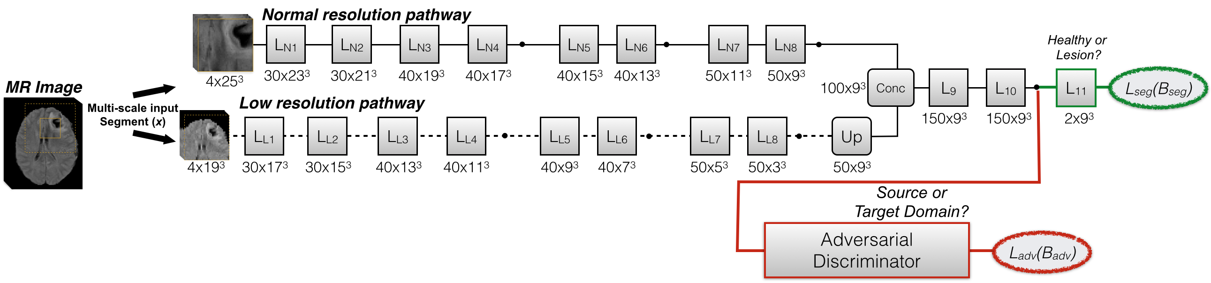
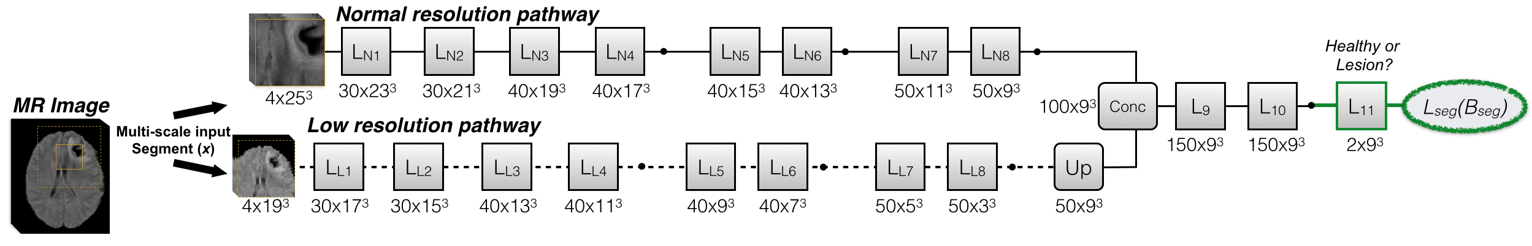
Segmentation System with Domain Discriminator
If h(x) not domain invariant:
Segmenter:
Domain Discr.:
Adapted Segmenter:
Notes:
Two words about the segmenter: Fully 3D. Important note, it operates on image segments or subvolumes, not whole images. Its design for being efficient. And chosen for this reason, as applicability of UDA with adversarials in 3D CNNs has not been previously shown, with considerations about whether it ll fit in memory have been expressed in literature.

Slide 11
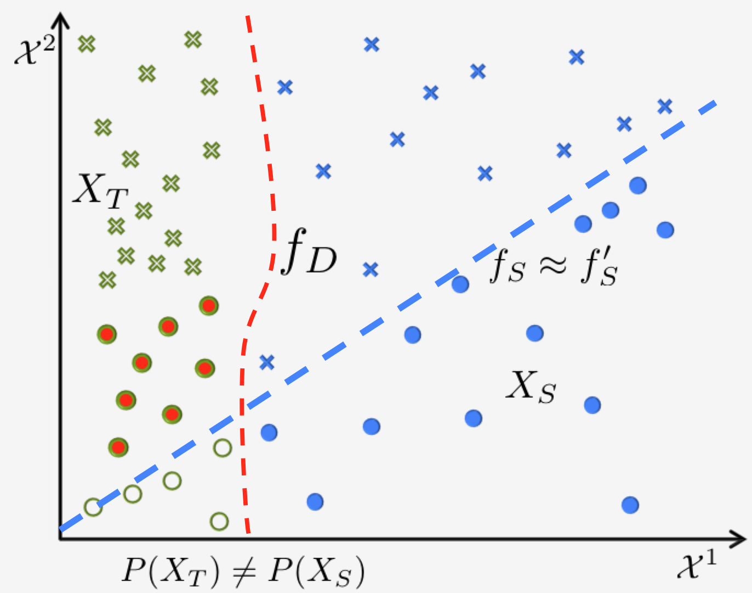
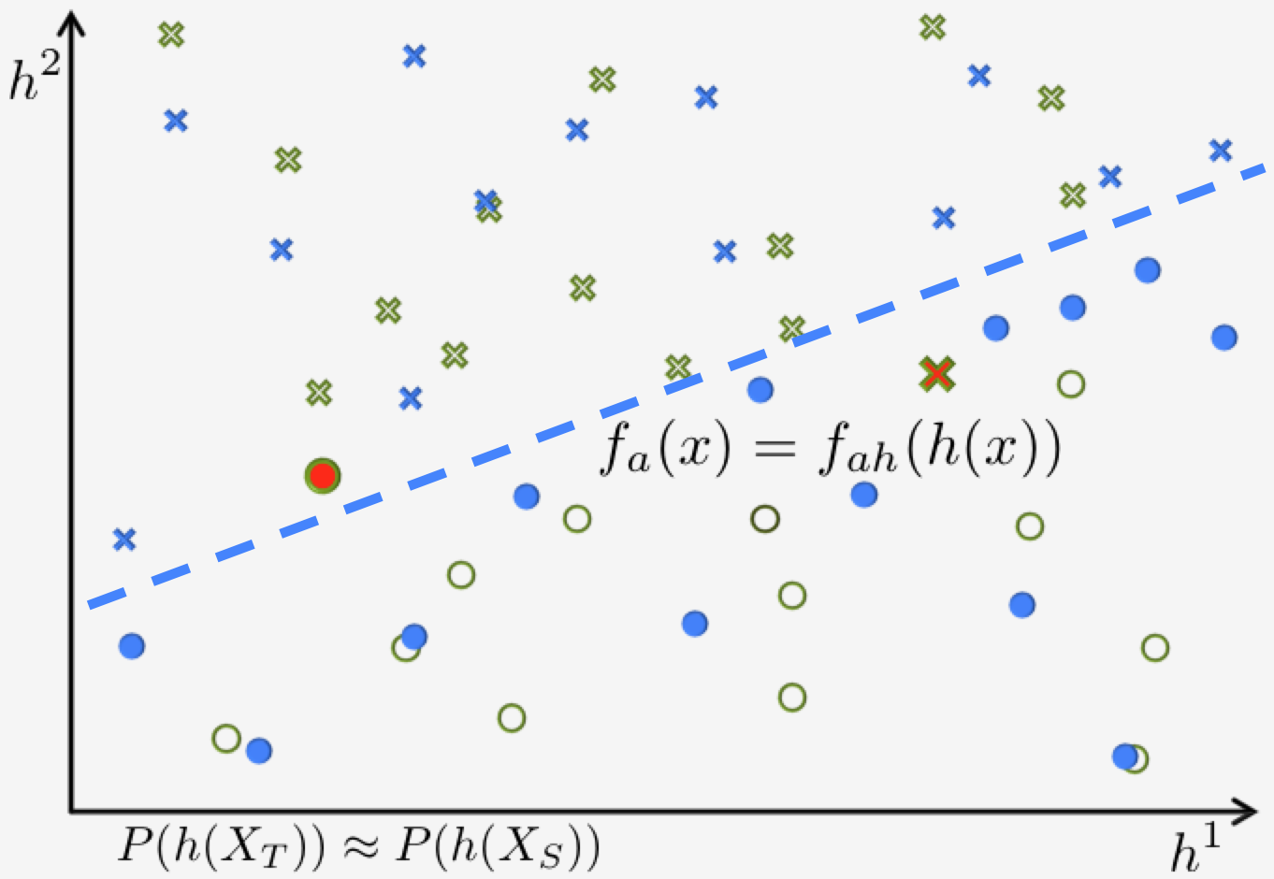
Representation change to domain-invariant space

Slide 12
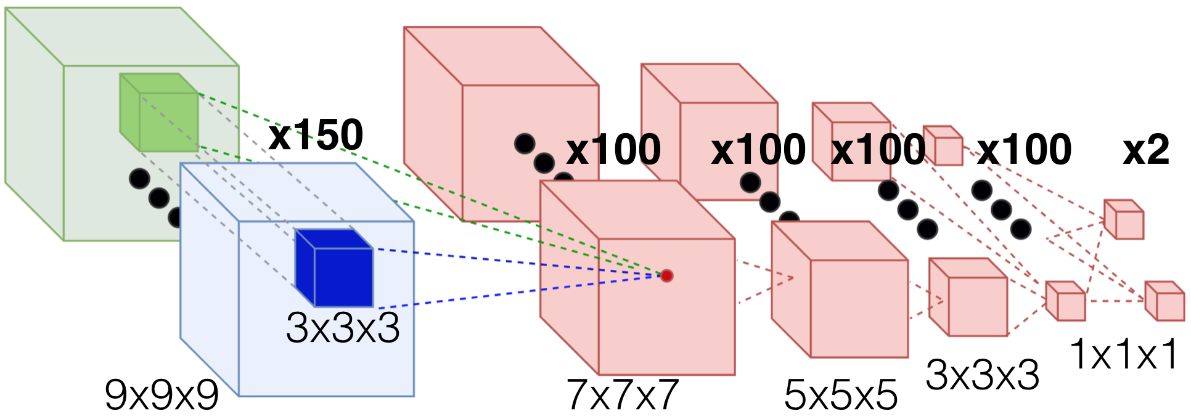
Domain discriminator
Small FoV on segmenter’s feature maps:
By construction, to be cheap for memory.
Aim is to process feature correlations.
Does not aim to offer spatial regularization.
Unlike GANs, for UDA rather small 3D domain discr. may be sufficient.
Notes:
Investigations:
No previous work on UDA for segmentation
GANs and SuperRes-Gan: Whole image.
Recent segmentation (even though they did not show sota results for segmentation) (Isola et al Nov’16, Luc et al Dec’16): 1x1 < 256x256 < 16x16 < 70x70 | 18x18 < 34x34

Slide 13
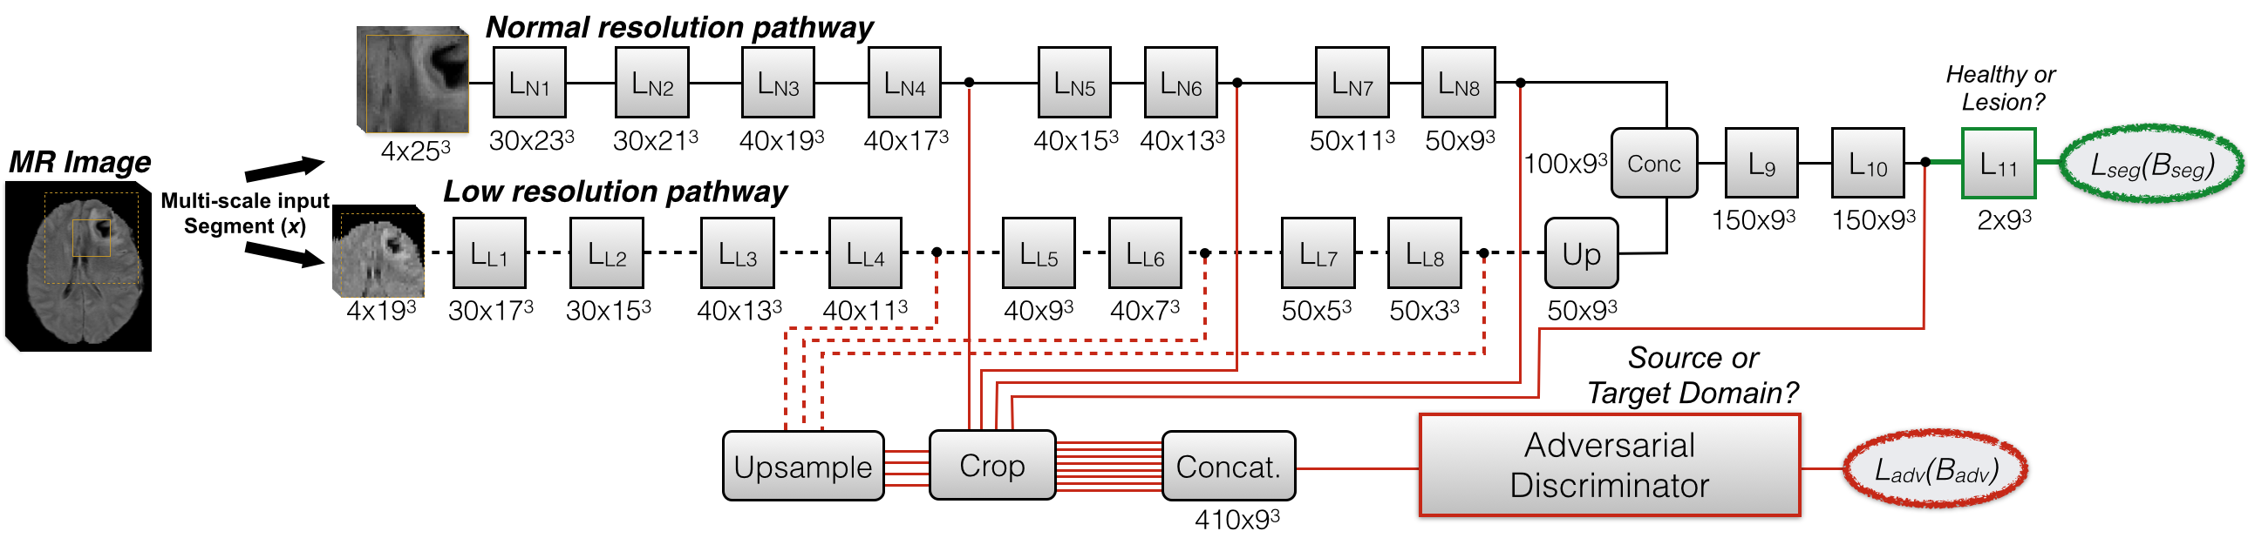
Multi-Connected Adversarials
Common belief they don’t need DA
Connections at multiple layers:
Learn domain-invariant filters from the early layers:
Otherwise wasted capacity, lower generalization in T.
Improve flow of adversarial gradients:
As deep-supervision [Lee AISTATS’15] with whole adversary seen as a loss.
Make domain-discriminator stronger, by processing more cues:
Better quality of adversarial gradients.

Slide 14
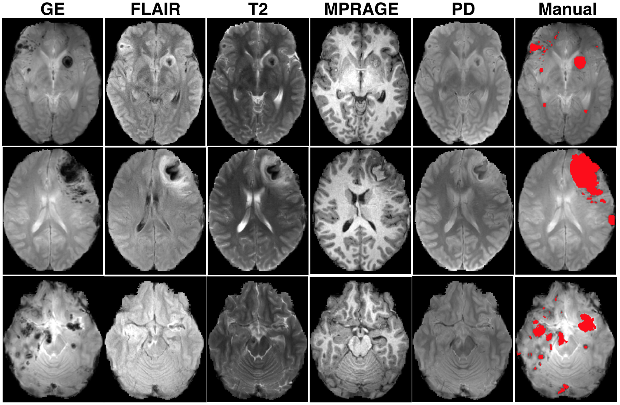
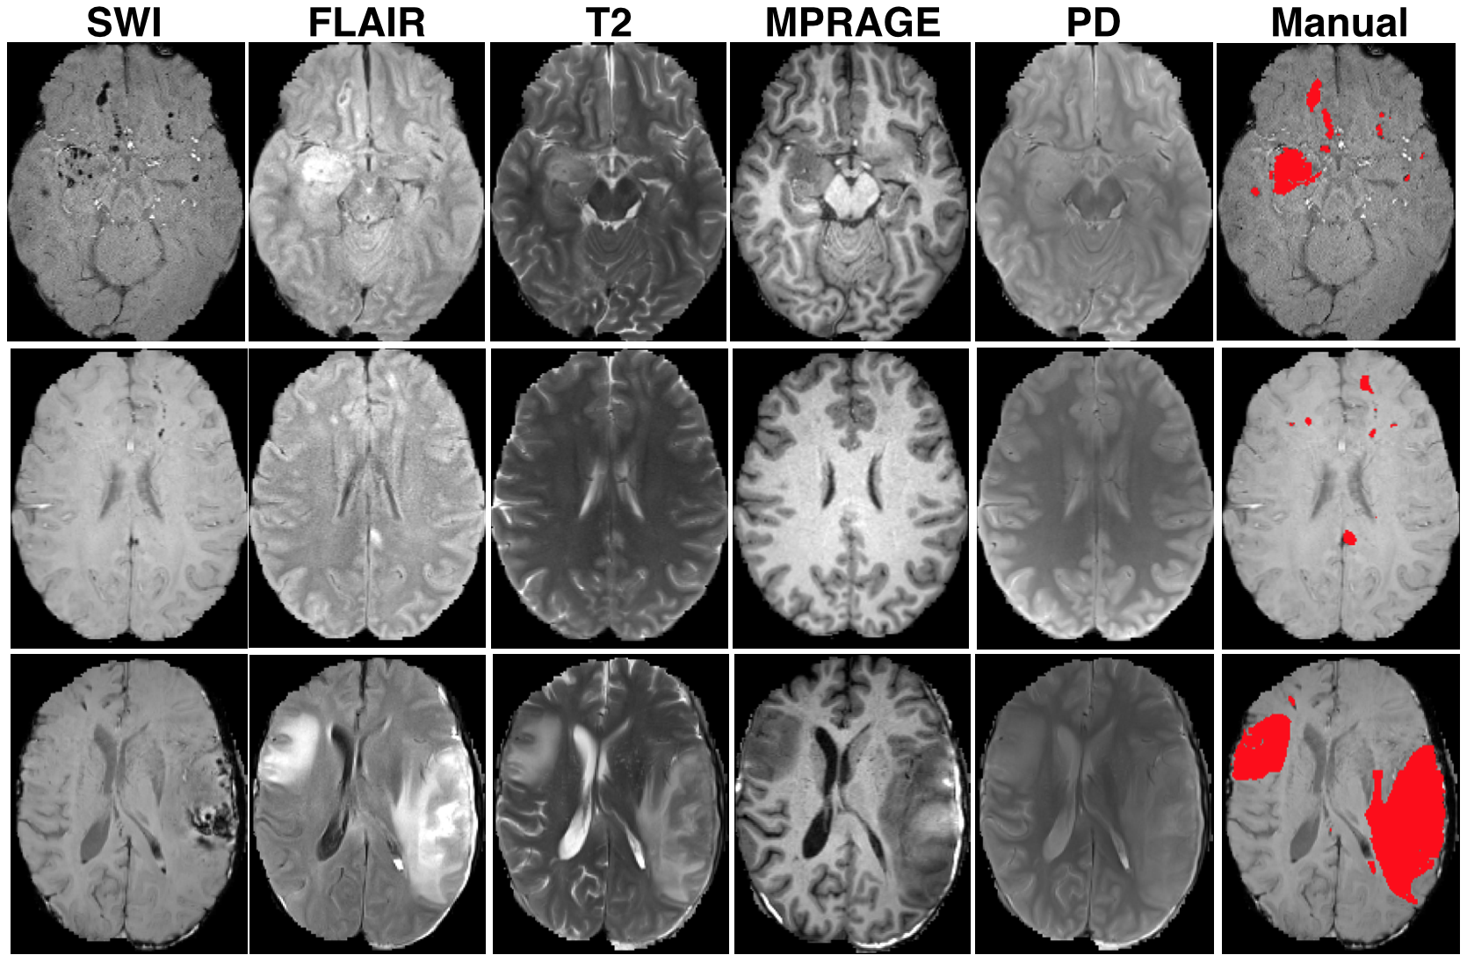
Material Source (S) and Target (T) data
Source (S)
61 subjects
Acute severe TBI
3T Siemens Trio
Subject #1
Subject #2
Target (T)
41 subjects
Acute severe TBI
3T Siemens Verio
Subject #3
Subject #4

Slide 15
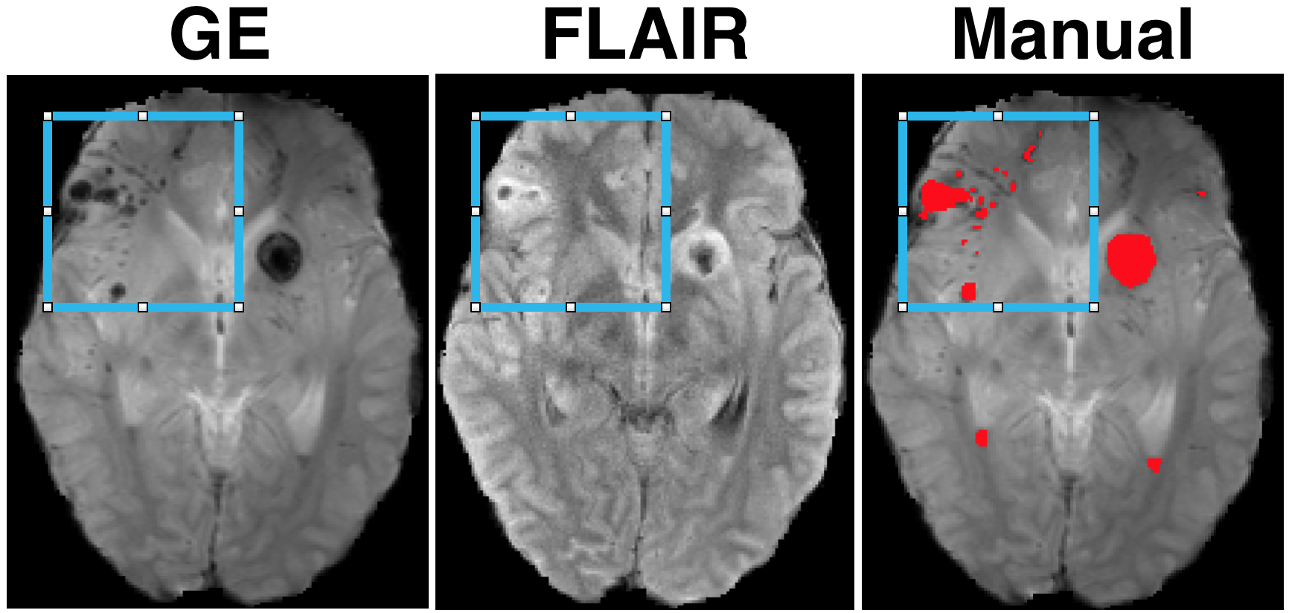
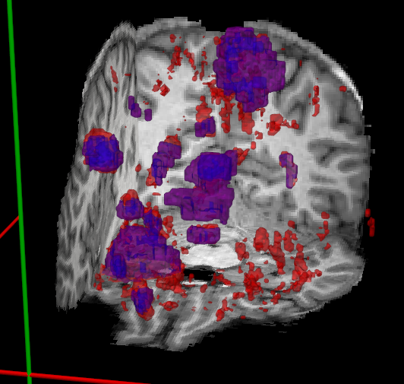
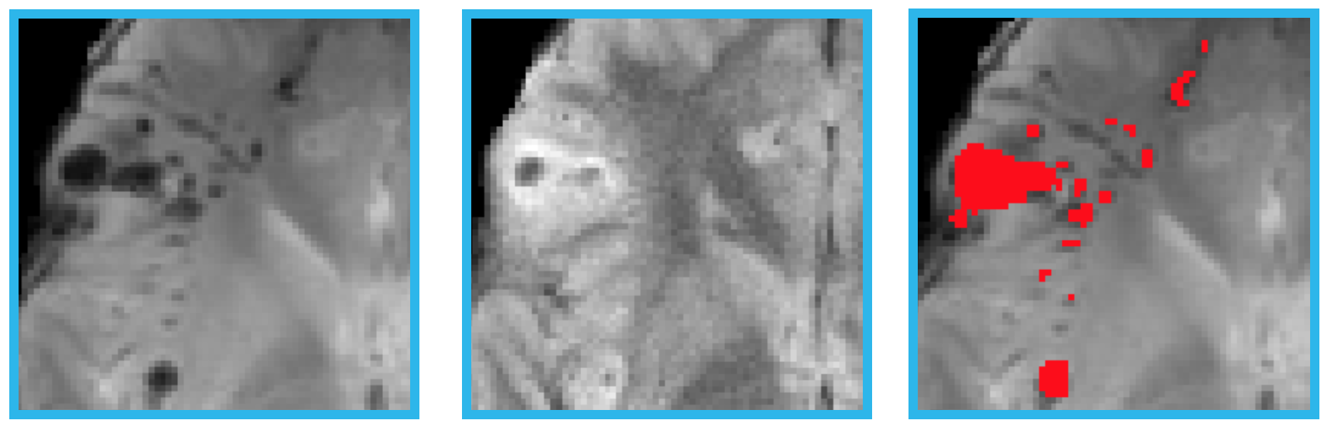
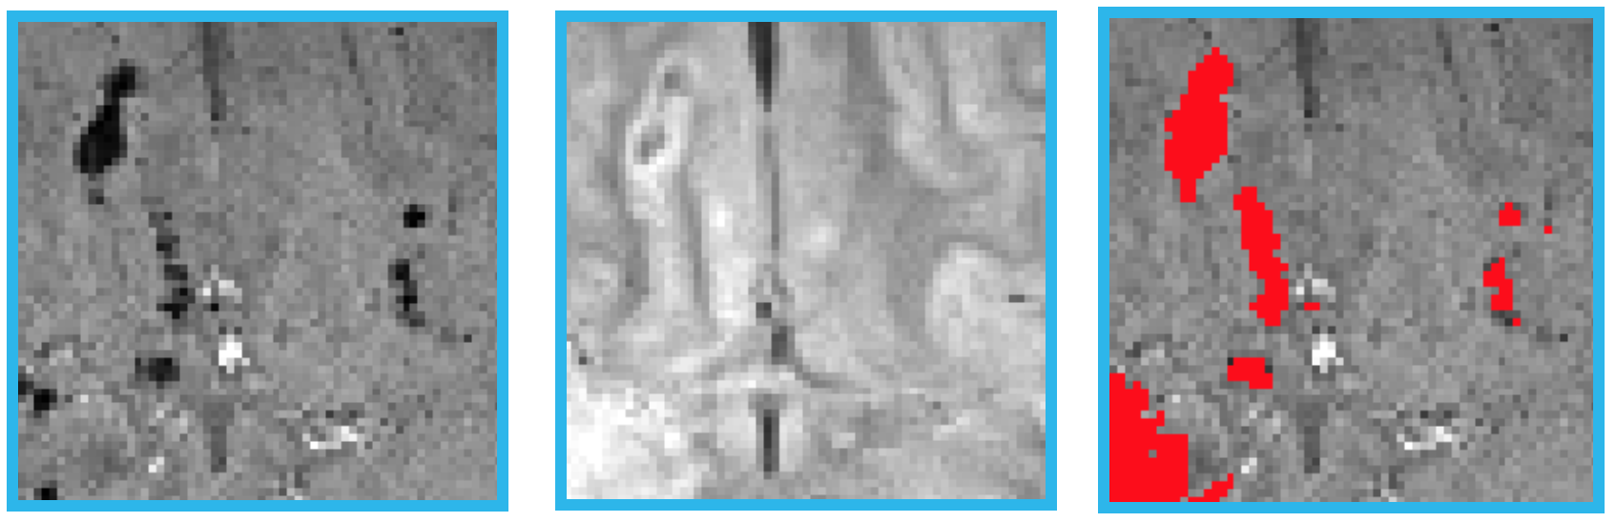
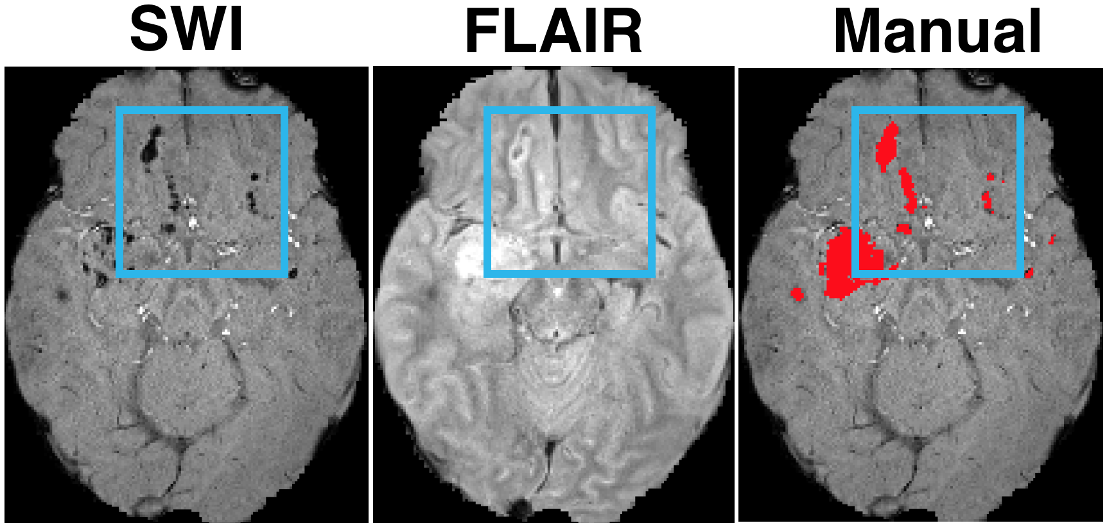
Material GE (in S) vs SWI (in T)
Source: Gradient Echo (GE)
Sensitive to iron (blood)
Used for detecting micro-bleeds
Lesions visible on:
FLAIR
On FLAIR+SWI
Target: Susceptibility Weighted Imaging (SWI)*
Type of GE (longer acquisition)
Greater sensitivity
Better quality
Used for micro-bleeds
(common exists)
* Shenton et al, brain imaging and behavior, 2012
Notes:
Ps: last assumption differentiates us from synthesis.

Slide 16
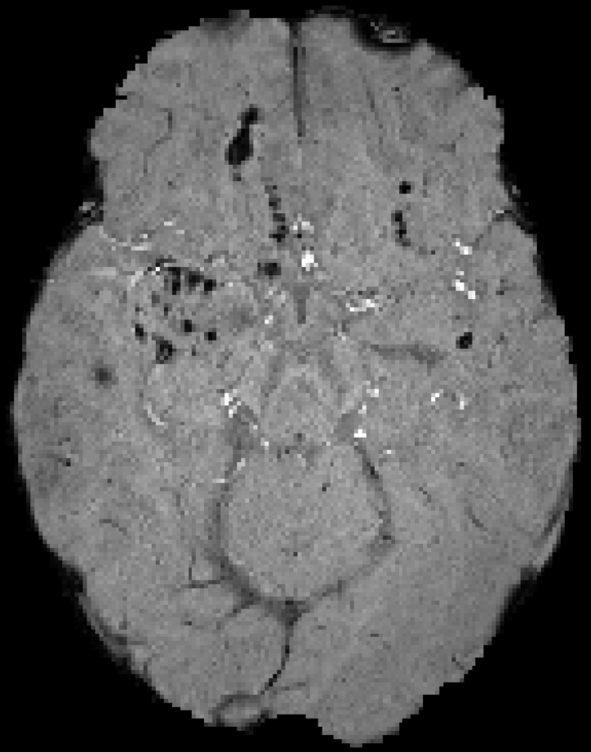
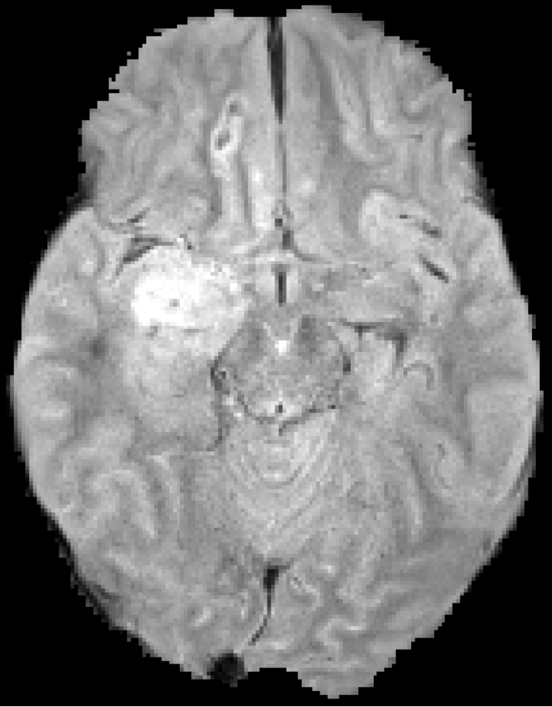
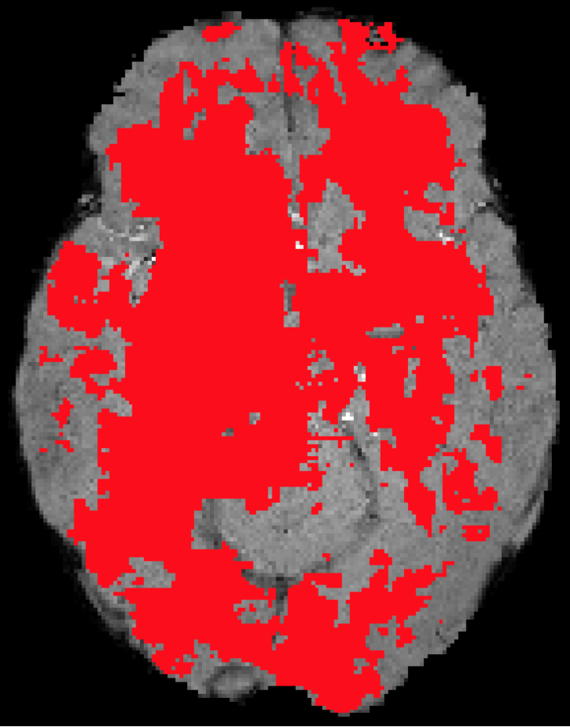
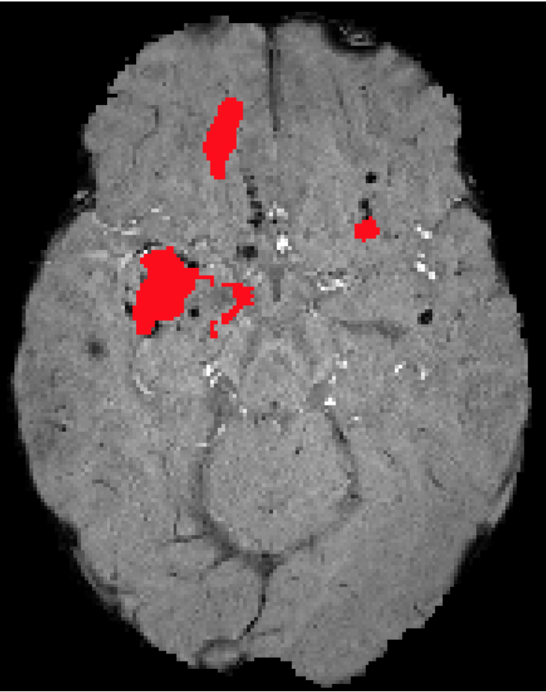
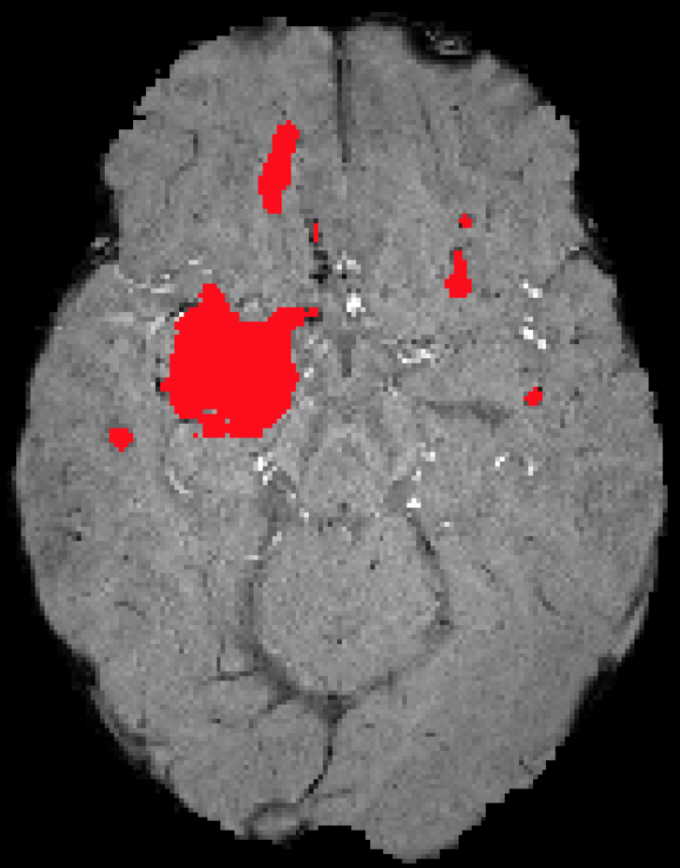
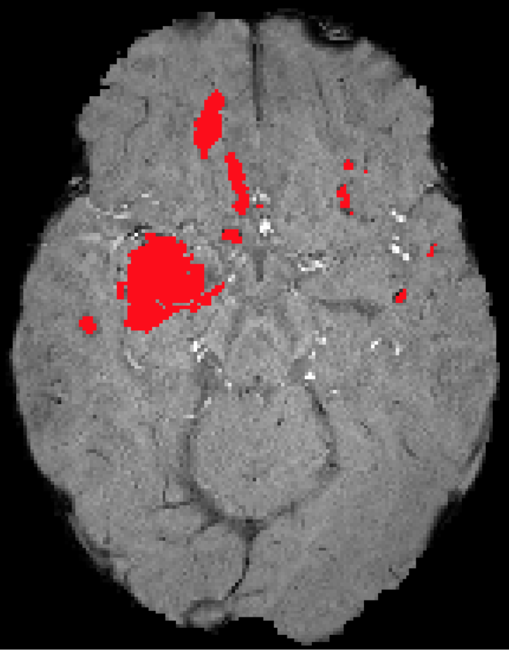
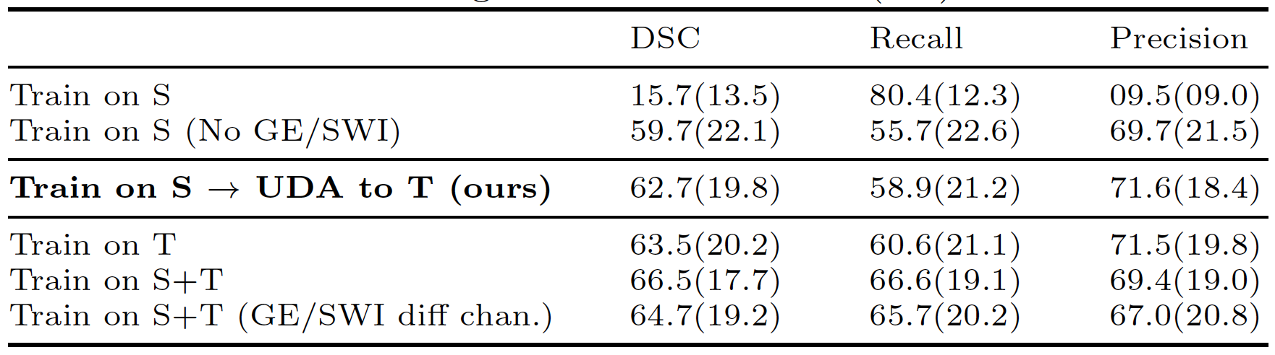
Evaluation - Quantitative
SWI
FLAIR
Train S (All Chann.)
Train S (No GE/SWI)
Train S, UDA to T (ours)
Manual
Target Domain
Superv. on T. Upper bounds
* All experiments used all 5 modalities except if otherwise noted, eventhough only SWI/Flair are depicted.
** Same CNN’s input channel was used for GE (S) and SWI (T) except if otherwise noted.

Slide 17
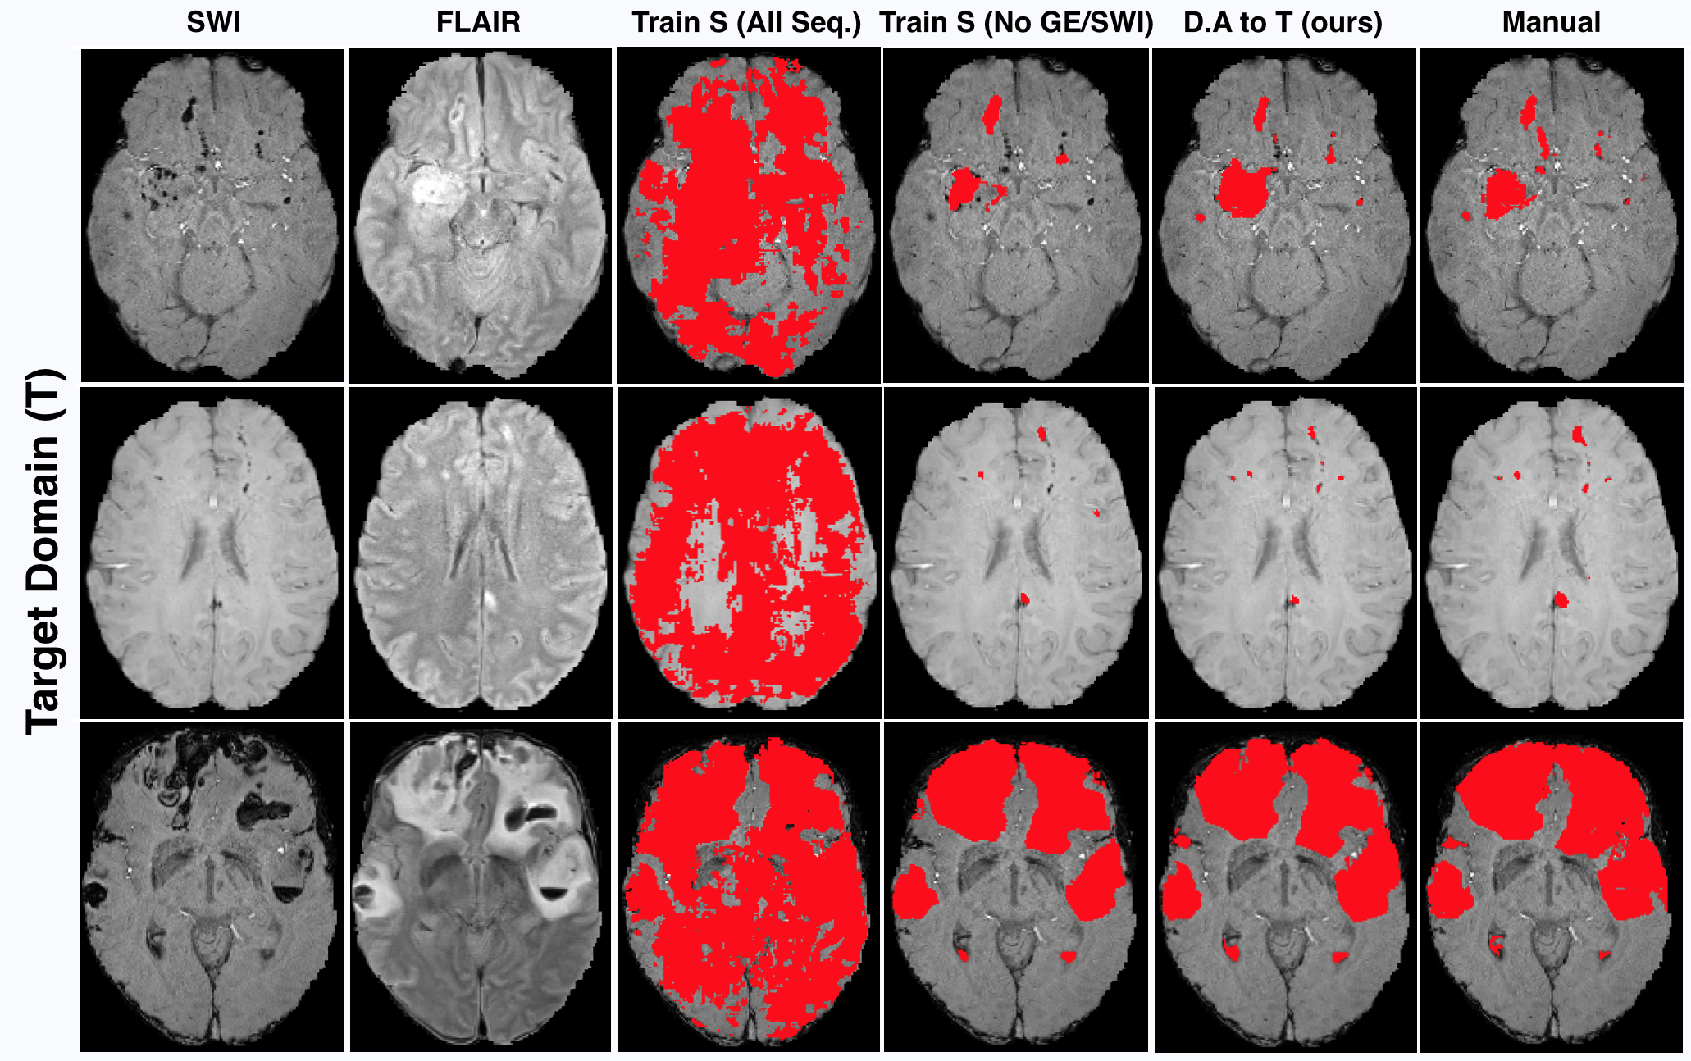
Evaluation - Qualitative

Slide 18
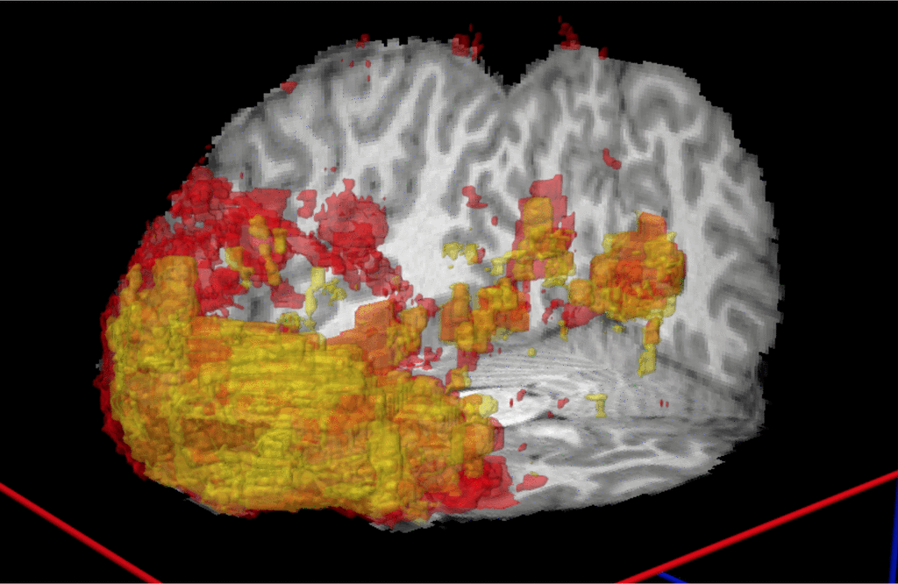
Evaluation – Qualitative Still way to go…
Segmentations on a T subject by:
Manual, all lesions
Predicted, trained on S, no GE/SWI, no adaptation
Predicted, trained on S, with GE/SWI, with adaptation

Slide 19
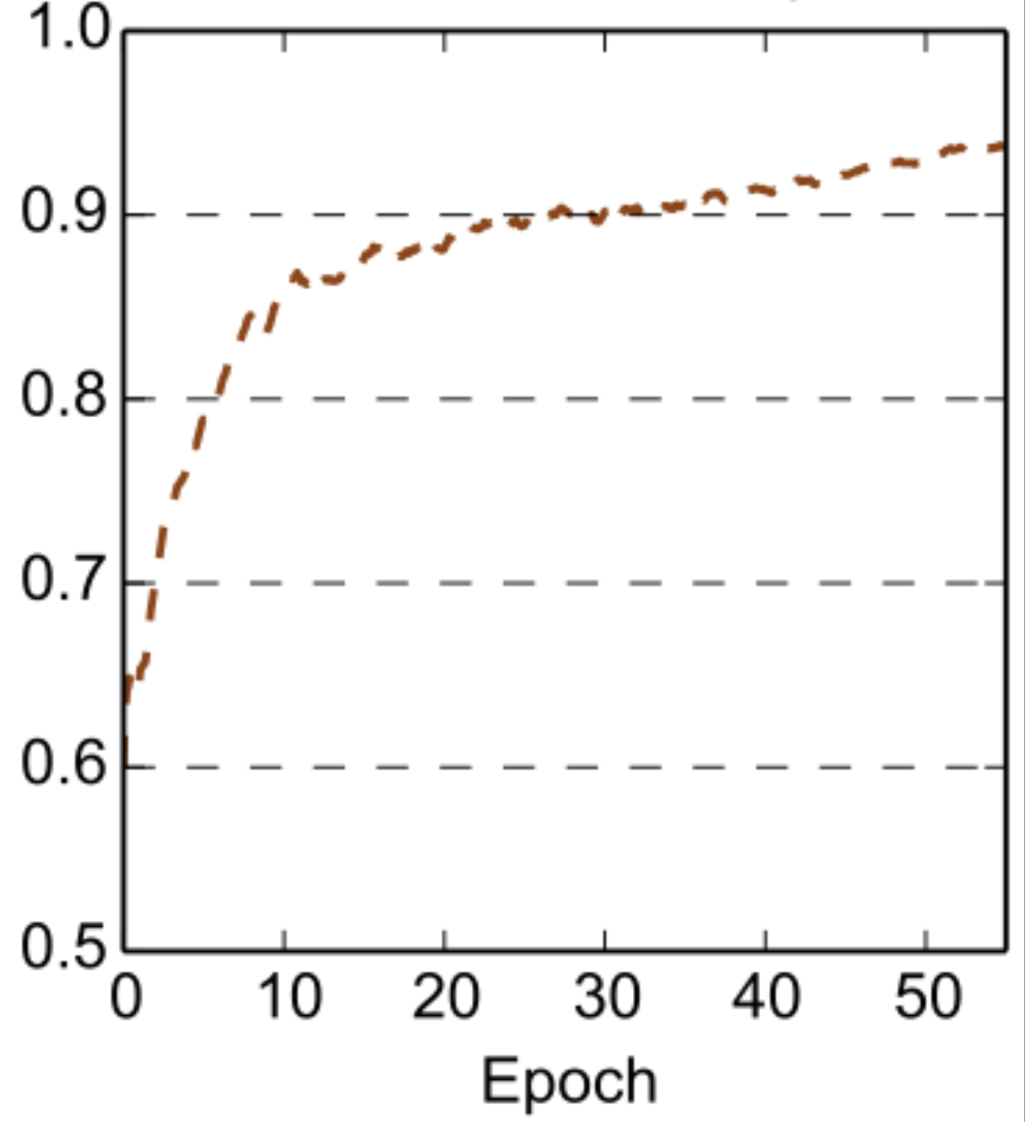
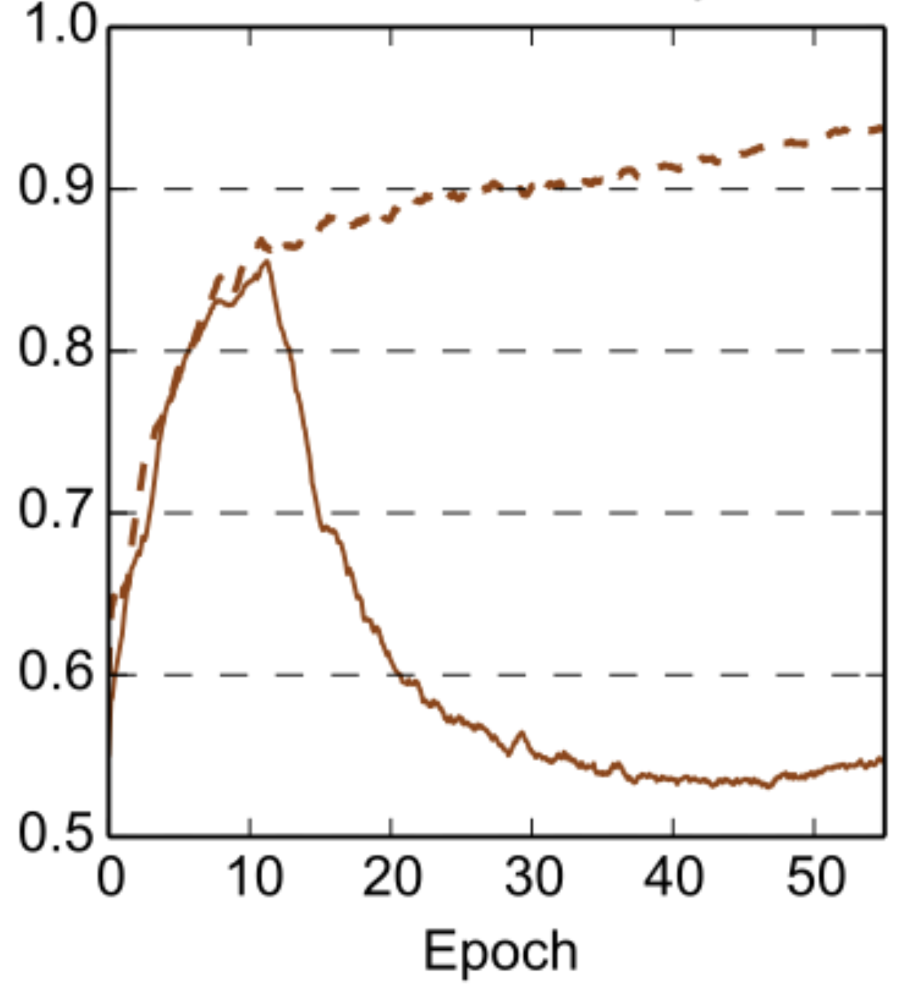
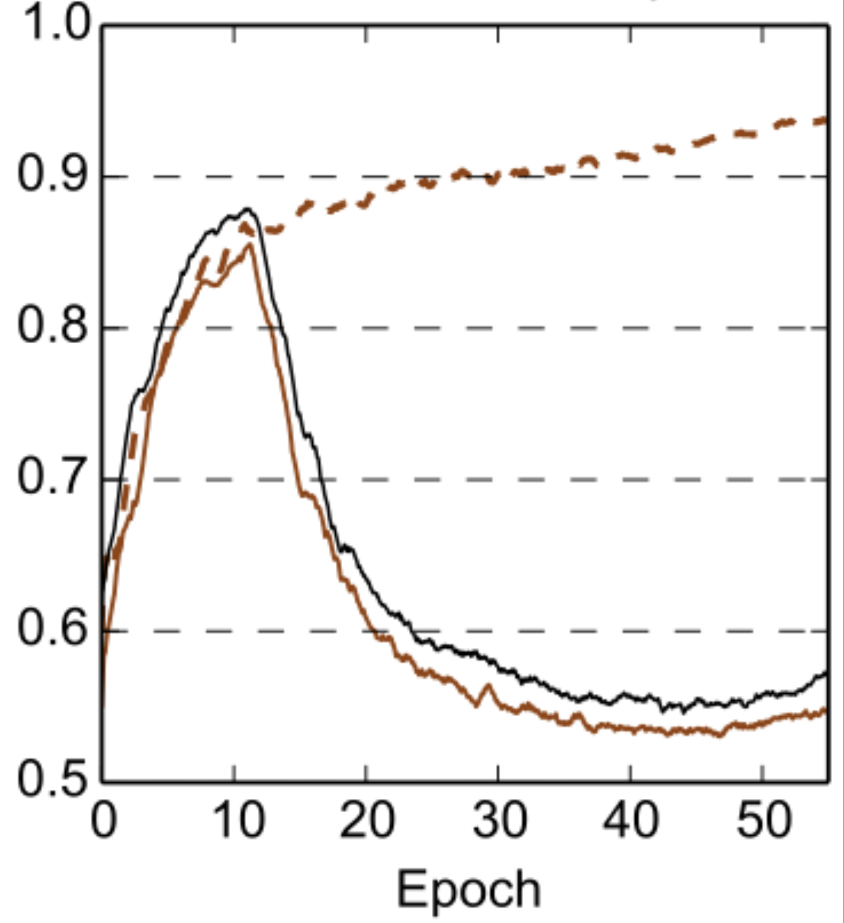
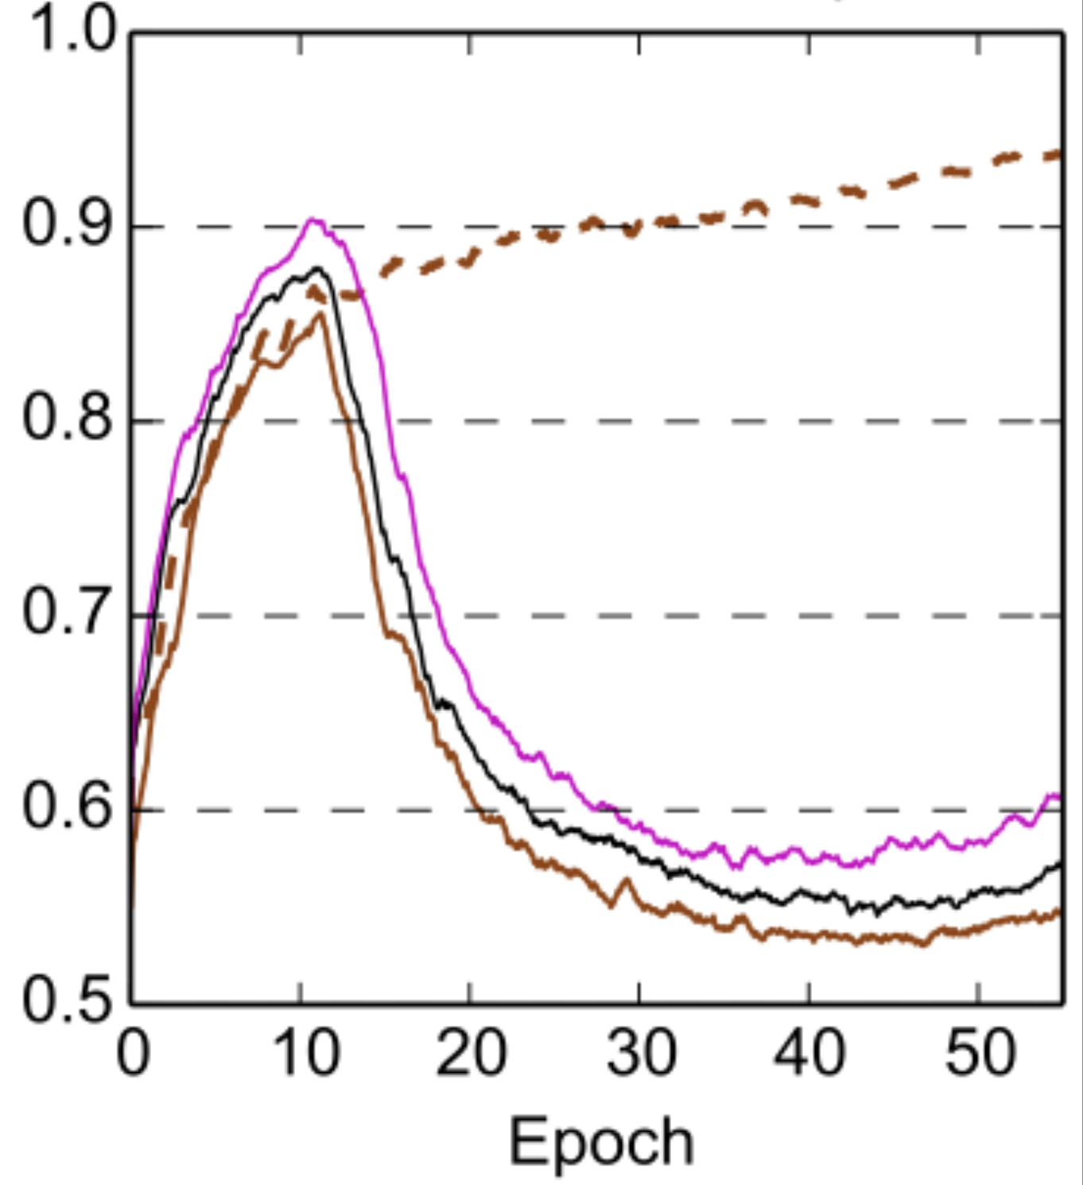
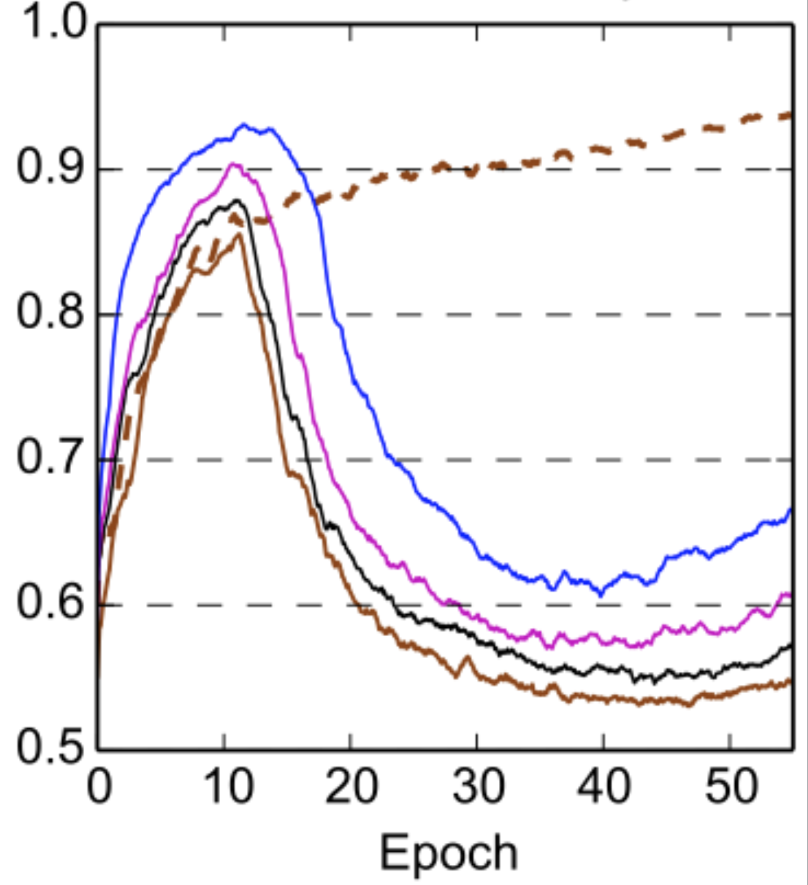
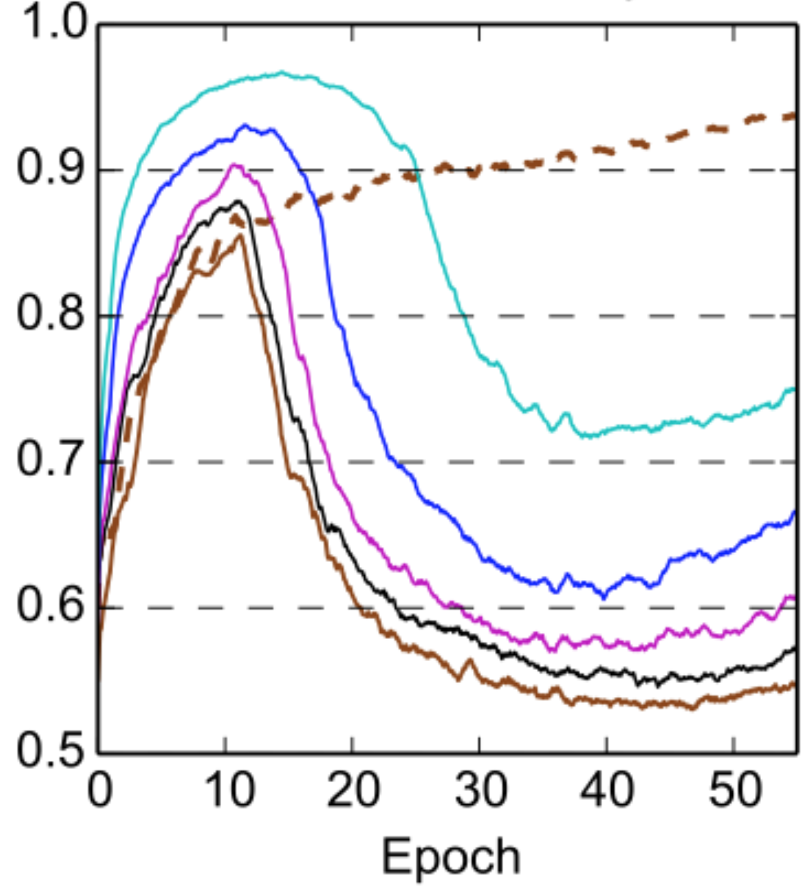
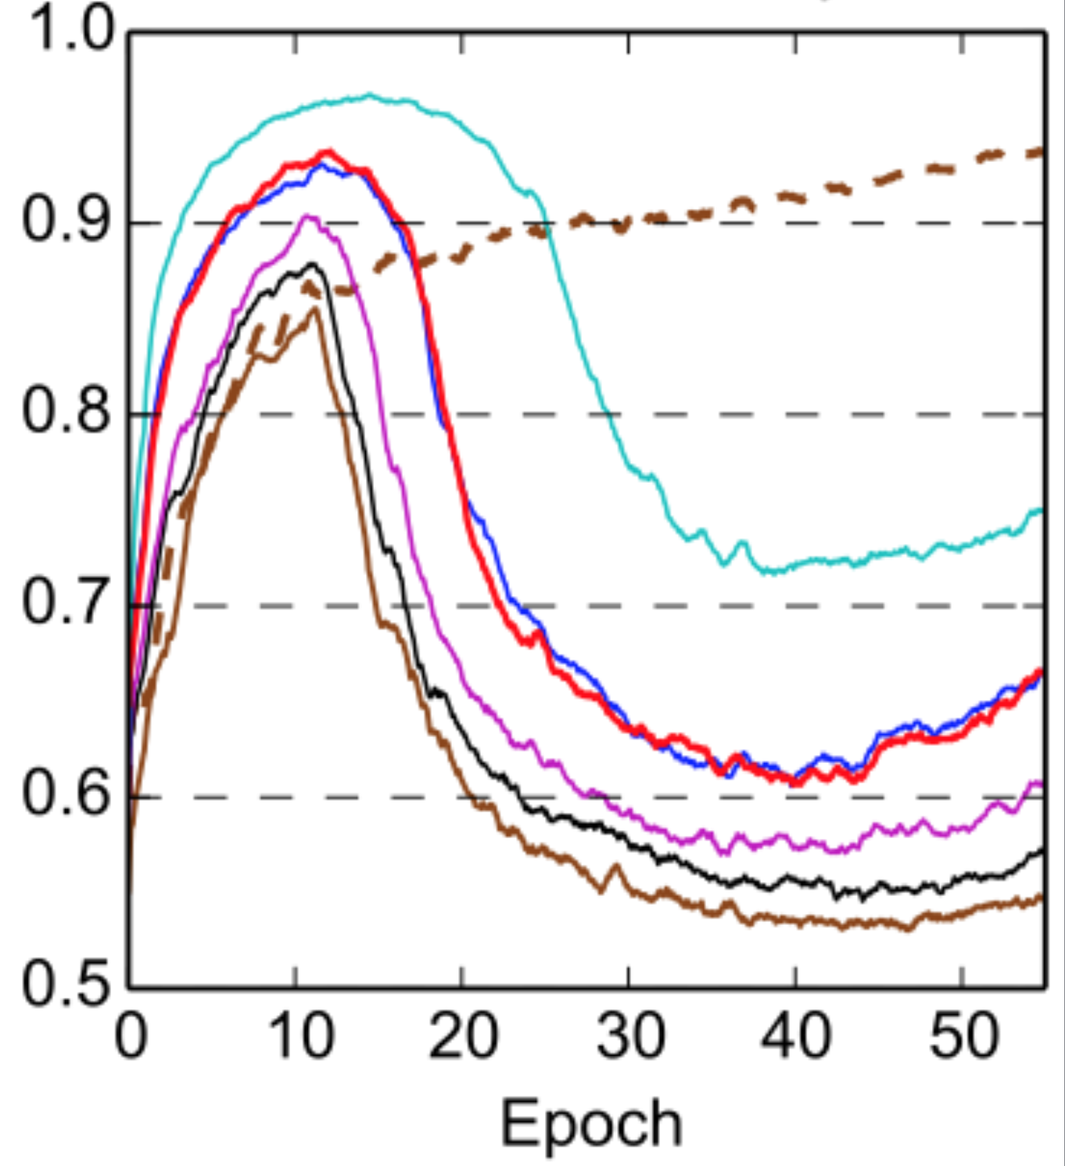
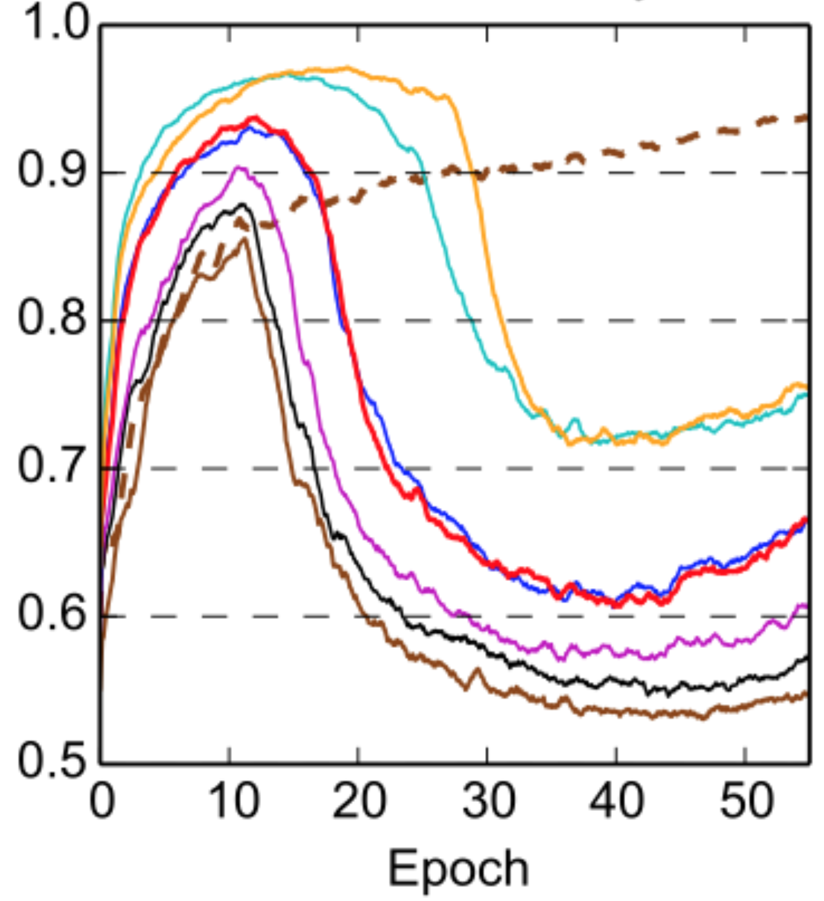
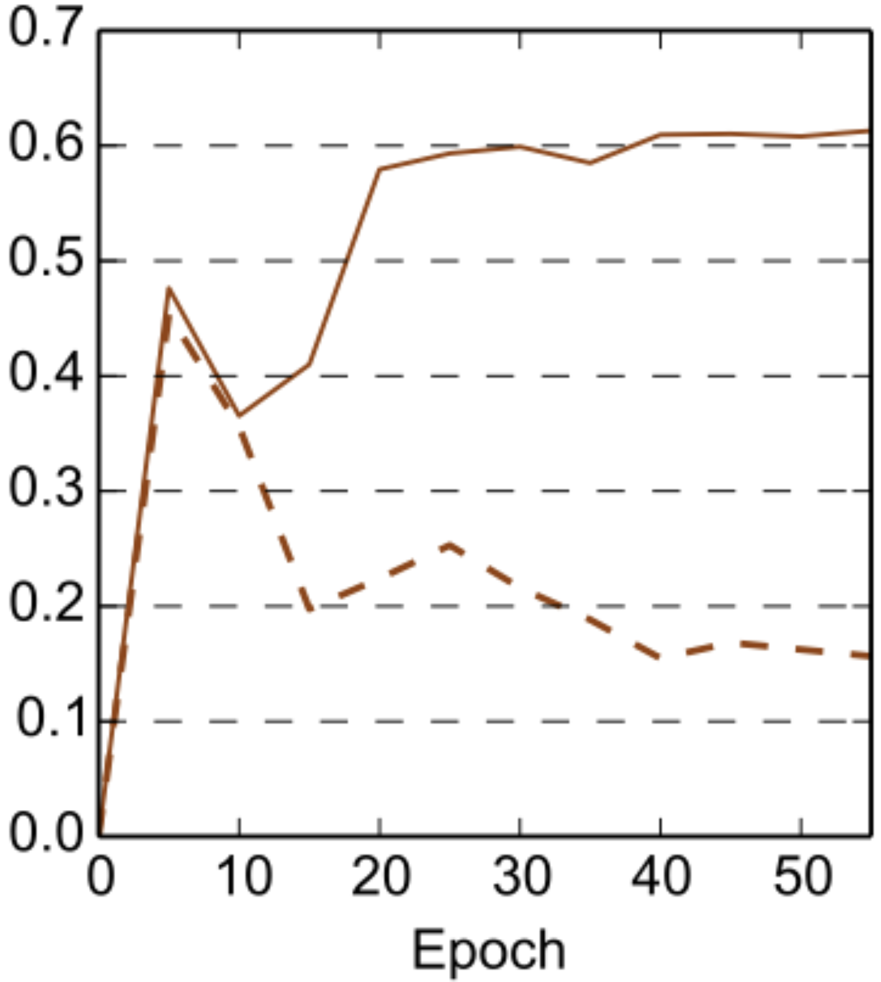
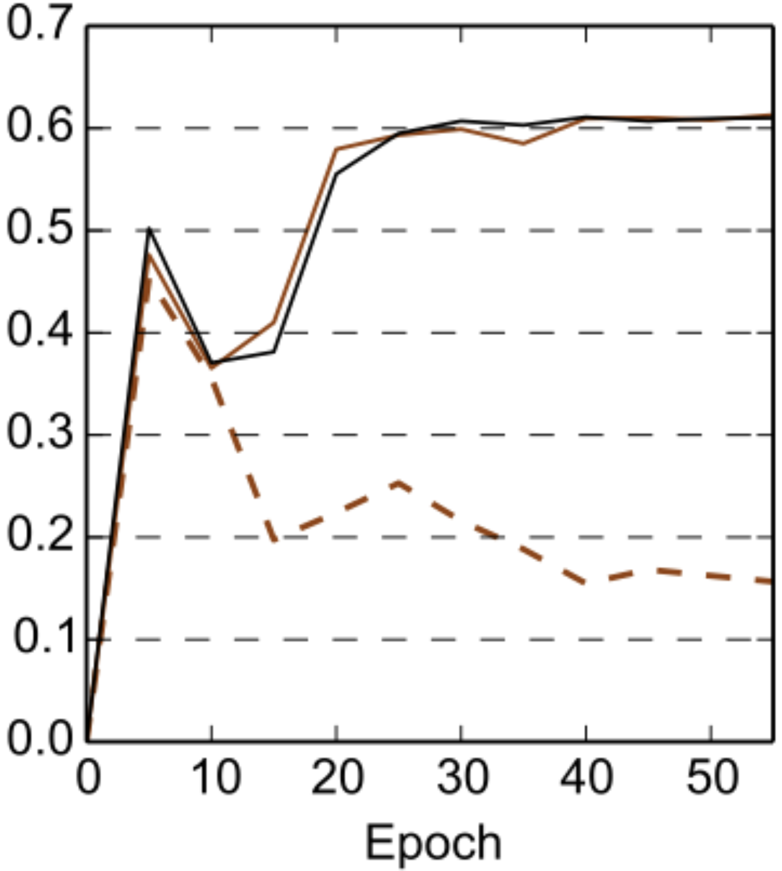






Analysis: Depth of adaptation
Domain Discriminator’s Accuracy
Segmenter’s DSC on T subjects
Notes:
Lower layers subject to domain shift!
Discriminator higher when giving lower layers too.

Slide 20

Analysis: Depth of adaptation
Accuracy of segmenter on T, when domain discriminator is connected at different depths.
Upper bound
Segmenter’s DSC on T subjects
Findings:
Early/middle layers are subject to domain shift.
Opposite to popular belief [Ganin JMLR’16, Long ICML’15].
Multiple connections at various depths perform better.
Notes:
As we previously saw, any of the connections will help alleviate the shift. (point at dsc and the plot)
But best works the multi-connected system, by 1.5% DSC over the L10 (common solution).
The number may not be large, but remember the upper bound is at 66.5 roughly.
An interesting point can be seen in the trends of Recall and Precision. Adaptation of lower layers leads to higher Sensitivity/Recall, lower Precision.
Compare L10 with L2.
Remember that when no adaptation is performed, the whole brain is getting segmented, ie very high Recall, low Precision.
It is only an assumption, but we believe this may be a sign that when only L2 is adapted, which gives high Recall lower Precision, maybe the network recovers domain-specific features between L2 and Classification layer, and thus starts leaning towards the trend of oversegmention.
Multiconnected system avoids this and leads to overall better results.

Slide 21



Analysis: Strength of adaptation
Drop > -1% DSC
for
Strongly countering discriminator does not guarantee better performance T:
Poor discriminator returns low quality adversarial gradients.
Invariance causes information loss. Trade-off with quality of learnt classifier [Ben-David NIPS’06].

Slide 22

Adversarial DA vs GAN
Discriminator’s accuracy in a GAN during training. (From: carpedm20/DCGAN)
Adversarial discriminator:
UDA: Easily countered in our UDA settings.
GAN: Too strong to counter (real/fake image easy task?).
Different issues:
UDA: How to improve D for better gradients? (Multi-connected, etc…)
GAN: How to avoid saturating. (WGAN, etc…)
Notes:
Important issue for GANs, that has seen loads of investigations, especially in the last 9/12 months or so.

Slide 23
Take home messages
What we’ve learnt:
UDA with 3D adversarial networks is feasible and promising.
Multi-connected networks improve performance.
Early layers are subject to domain shift.
Adversarials for Domain Adaptation behave differently than GANs!
Future investigations:
How to devise stronger domain discriminators?
Can we avoid the trade-off: Invariance Vs quality of classifier?

Slide 24





Unsupervised domain adaptation in brain lesion segmentation with adversarial networks
Baseline
With adaptation
Acknowledgements:

Slide 25
References
Bakas et al, “GLISTRboost: Combining multimodal MRI segmentation, registration, and biophysical tumor growth modelling with gradient boosting machines for glioma segmentation”, Brainlesion..., 2016
Ben-David et al, A theory of learning from different domains. Mach. learning 79(1-2), 151–175 (2010)
Ben-David, Analysis of representations for domain adaptation, NIPS, 2006
Ciompi et al, “Automatic classication of pulmonary perifissural nodules in computed tomography using an ensemble of 2d views and a convolutional neural network out-of-the-box”, MedIA, 2015.
Ganin et al, Domain-adversarial training of neural networks. Journal of Machine Learning Research 17(59), 1–35 (2016)
Goetz et al, “DALSA: Domain Adaptation for Supervised Learning from Sparsely Annotated MR Images”, TMI 2016
Goodfellow, Generative adversarial nets. In: NIPS (2014)
Heimann et al, Learning without labeling: Domain adaptation for ultrasound transducer localization., MICCAI 2013
Isola, Image-to-Image Translation with Conditional Adversarial Networks, arXiv 2016.
Jiang, J.: A literature survey on domain adaptation of statistical classifiers. URL: http://sifaka. cs. uiuc. edu/jiang4/domainadaptation/survey (2008)
Kamnitsas et al, “Efficient multi-scale 3D CNN with fully connected CRF for accurate brain lesion segmentation”, MedIA, 2017
Lee, C.Y., Xie, S., Gallagher, P., Zhang, Z., Tu, Z.: Deeply-supervised nets. In: AISTATS. vol. 2, p. 6 (2015)
Long, M., Cao, Y.,Wang, J., Jordan, M.: Learning transferable features with deep adaptation networks. In: ICML (2015)
Maier et al, “ISLES 2015 - A public evaluation benchmark for ischemic stroke lesion segmentation from multispectral MRI”, MedIA, 2017.
Moeskops et al, “Deep learning for multi-task medical image segmentation in multiple modalities.”, MICCAI 2016
Pan, S.J., Yang, Q.: A survey on transfer learning. IEEE Transactions on knowledge and data engineering 22(10), 1345–1359 (2010)
Peres et al, “Brain Tumor Segmentation using Convolutional Neural Networks in MRI Images”, TMI, 2016
Shenton et al.: A review of magnetic resonance imaging and diffusion tensor imaging findings in mild traumatic brain injury. Brain imaging and behavior 6(2), 137–192 (2012)
Shin et al, “Deep convolutional neural networks for computer-aided detection: Cnn architectures, dataset characteristics and transfer learning”, TMI, 2016.
Ullman, S., Assif, L., Fetaya, E., Harari, D.: Atoms of recognition in human and computer vision. Proc. of the Nat. Academy of Sciences 113(10), 2744–2749 (2016)
Valiant, L.G.: A theory of the learnable. Commun. ACM 27(11), 1134–1142 (Nov 1984), http://doi.acm.org/10.1145/1968.1972
van Opbroek et al: Transfer learning improves supervised image segmentation across imaging protocols. TMI 34(5), 1018–1030 (2015)
van Opbroek et al, Weighting training images by maximizing distribution similarity for supervised segmentation across scanners, MedIA, (2015)
Wulfmeier et al, Addressing Appearance Change in Outdoor Robotics with Adversarial Domain Adaptation, arXiv, March 2017

